Slide 1



Agrifood trade and gender equality:
some key dimensions and implications for developing countries
Trade & Gender Seminar Cycle
Master in Development Economics and International Cooperation (MESCI)
School of Economics – University of Rome “Tor Vergata”
15 March 2023
Evelyne van Heck, PhD.
Trade and gender specialist
Markets and Trade Division (EST)
Food and Agriculture Organization of the United Nations (FAO)

Slide 2
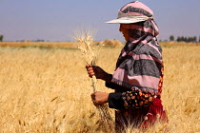
THE GENDER GAP IN AGRICULTURE AND AGRIFOOD TRADE
Agriculture is the main source of income and employment for millions of rural smallholders worldwide. In 2020, women accounted for over 37 percent of global agricultural workforce, a share that raises to 48 percent in low-income countries (FAO, 2022a).
Gender discriminatory norms and practices affect societies at all levels, from households to communities, institutions and policymaking processes.
Gender inequalities intersect with other forms of discrimination against social identities (‘intersectional discrimination’).
Trade is an engine for economic growth and poverty reduction. Agrifood trade can help balance food deficits and surpluses across countries, improve availability of diverse foods, and contribute to price stability.
Trade can lead to economic and social outcomes potentially conducive to gender equality and women’s empowerment. Important in the agriculture sector in developing countries where women are largely employed.
Women’s barriers to agrifood markets and trade are part of broader gender inequality dynamics in agrifood systems.
Examples:
Gendered division of labour/occupational segregation. In many contexts, women work in low value-added agrifood value chains carrying out labour-intensive tasks especially in the production node.
Low participation in commercial agriculture. Women are less likely to produce cash crops and enter profitable markets (productivity gap, mobility constraints, time poverty, poor market linkages, etc.).
Low participation in international trade. Women often trade low value added products in informal local markets (insufficient capacities, financial gap, discriminatory legal frameworks, etc.).
© FAO/Mazen Haffar

Slide 3
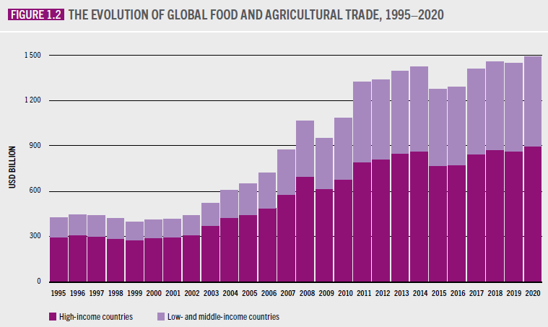
GLOBAL AGRIFOOD TRADE
Since 1995, global agrifood trade has more than doubled, amounting to USD 1.5 trillion in 2018.
The value of trade in food and agricultural products accelerated between 2000 and 2008, then slumped with the global financial crisis of 2008–09. Growth has since been slow.
Food and agricultural markets have become more globalized.
One-third of agricultural and food exports were traded within a global value chain in 2015.
Growing levels of South-South trade within and between regions.
Agrifood systems proved to be resilient in front of the COVID-19 pandemic disruptions, compared to other sectors
Source: FAO. 2022. The State of Agricultural Commodity Markets 2022. https://doi.org/10.4060/cc0471en (FAO, 2022b)

Slide 4
TRADE OPENNESS AND GENDER EQUALITY
Trade openness was found associated with gender equality performance, as measured by the UNDP Gender Inequality Index (GII) (World Bank and WTO, 2020).
In 2021, regions performing better in gender equality (having low GII values), with the exception of Arab countries, are also the regions more open to trade.
A negative correlation (r = -0.51) between trade openness and GII was found for 116 observed countries in 2021.
1. Gender equality performance and trade openness in 2021, by region
2. Gender inequality and trade openness in 2021 (116 countries)
Region | GII | Trade (% of GDP)
Europe and Central Asia | 0.227 | 85
East Asia and the Pacific | 0.337 | 60
Latin America and the Caribbean | 0.381 | 53
South Asia | 0.508 | 41
Arab States* | 0.536 | 74
Sub-Saharan Africa* | 0.569 | 50
Least developed countries | 0.562 | 46
World | 0.465 | 52
*Data refers to 2020 as not available for 2021.
Source: own calculations based on data from UNDP 2022. Human development reports 2022. Gender inequality index; World Bank 2022. Trade (%) GDP. World Bank Data.

Slide 5
THE TRADE AND GENDER NEXUS IN AGRICULTURE
The links between trade and gender (in)equality stem from the fact that societies and economies are organized around gendered structures and processes, that is, they are biased by explicit or implicit gender norms and sociocultural practices which directly or indirectly affect the distribution of (and power over) resources among women and men.
Literature suggests a two-way pathway of interaction between trade and gender:
Trade has gender-differentiated redistributive effects which can either magnify or reduce existing inequalities depending on various factors and underlying societal conditions.
Women gaining in one trade-related area, like employment, may be disadvantaged in another one.
Trade and gender dynamics are context-specific and not easy to disentangle, especially in informal contexts.
More research is needed in the trade and gender area.
Gender (in)equality can have macroeconomic implications by affecting market labour dynamics, value chain functioning, trade performance and economic growth.
EXAMPLE
Growing agrifood production intensification and commercialization are affecting the socioeconomic organization of small-scale farming systems in X country where development interventions are being implemented. The increasing farm household market participation is leading to diversified outcomes on women and men, still largely under-assessed.
What are the gender impacts of the increasing smallholders’ market participation under conditions of intensifying commercialization?
How to assess gender dynamics along the value chain, in the context of the market-driven agricultural sector transformation occurring in country X?

Slide 6
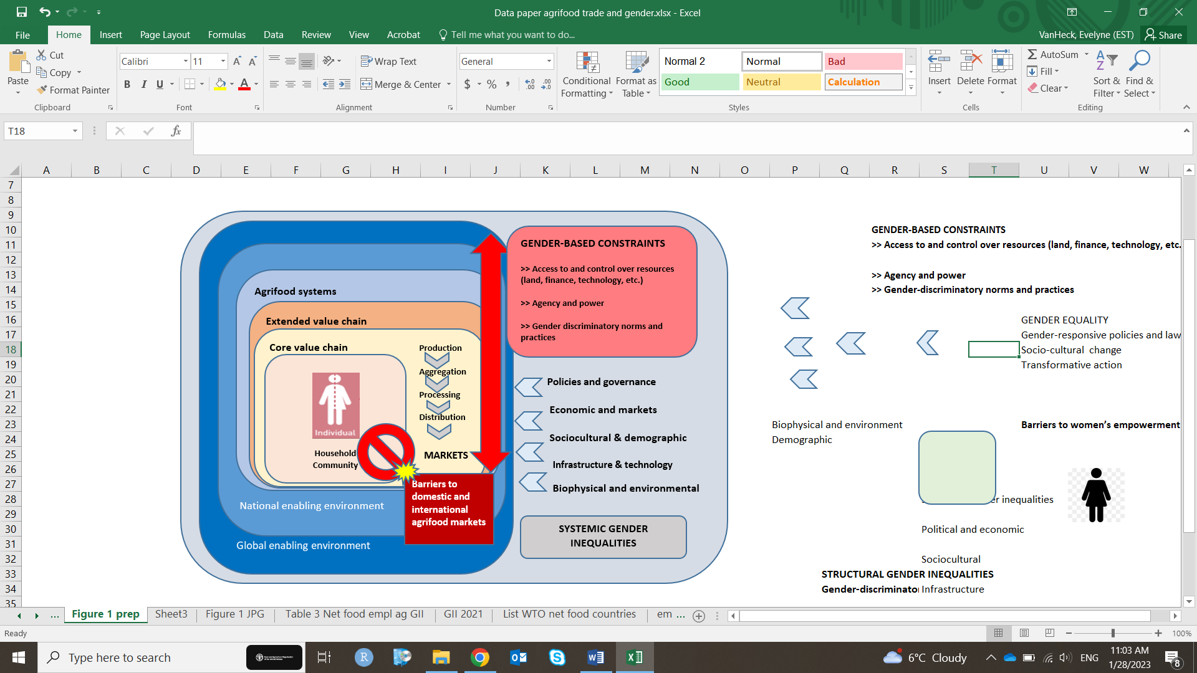
ADOPTING A GENDER-SENSITIVE VALUE CHAIN APPROACH
Gender relations are a primary component of the socioeconomic context shaping the value chain functioning.
Gender inequalities in agrifood markets are biased by context-specific factors and systemic conditions encompassing the local, national and global level.
The FAO’s gender-sensitive value chain framework (GSVCF) views gender equality as an essential dimension of sustainability.
Gender analysis is not about women but about gender relationships and power dynamics.
Programmes and projects need to ensure that processes of growth in the agricultural sector do not lead to harmful social outcomes, but contribute to the sustainable development of agrifood systems.
Source: adapted from the FAO Gender-sensitive value chain framework (GSVCF). FAO. 2016. Developing gender-sensitive value chains – A guiding framework. Rome, FAO.

Slide 7
EASTERN AFRICAN DAIRY VALUE CHAINS: WHAT PROSPECTS FOR WOMEN IN TRADE? (1)
FAO study
(in progress)
Eastern African dairy value chains: what prospects for women in trade?
Gender policy developments for inclusive dairy markets in Ethiopia, Kenya and Rwanda
Background
Globally, the dairy sector is one of the most rapidly growing agricultural subsectors.
In 2020, Eastern Africa accounted for about 46 percent of total milk production in Africa. Intra-regional dairy trade is slowly but steadily rising, with potential for expansion thanks to trade policy reforms and modernization of dairy production, processing and marketing systems.
Yet, dairying is still a subsistence-oriented activity and trade a smallholder-driven business mostly run in informal markets.
Study aim:
Generate gender evidence on the gender-differentiated costs and benefits of dairy commercialization and trade in support of the formulation and implementation of gender-responsive policies and programmes.
Main activities:
Gender analysis of national policies and programmes in agriculture and trade relevant to the dairy sector to assess their overall gender responsiveness;
Review of regional and national dairy value chains with focus on markets and trade, from a gender perspective.

Slide 8
EASTERN AFRICAN DAIRY VALUE CHAINS: WHAT PROSPECTS FOR WOMEN IN TRADE? (2)
Gender dynamics along the dairy value chain
Notwithstanding high variability, a few recurrent gender patterns can be found across and within national landscapes:
Women more involved than men in the low-skilled labour-intensive activities upstream (feeding, milking, cleaning); value chain participation tends to decrease further downstream;
Women may decide how to use the revenues generated from milk sales, but less likely when engaging in commercial dairying;
When trading, women mostly operate in informal local markets poorly linked to profitable markets;
Poor representation/leadership positions in dairy cooperatives and stakeholder organizations;
Very low participation in international trade.
Gender impacts of the market-oriented development of the dairy sector
Mixed evidence on the gender-related outcomes of increased farms’ milk market participation: empowering and disempowering effects on women.
Empowering effects
Disempowering effects
Increased productivity and income in small-scale dairy farm households with beneficial nutritional outcomes.
Increased control over sales decisions;
Greater engagement in off-farm activities;
Improved voice and representation in stakeholder organizations.
increased unpaid and domestic workload in absence of labour-saving technology;
Decreased control over income in favour of men;
Intra-household conflicts over dairy-derived income and resource allocation;
Milk market exclusion and marginalization.

Slide 9
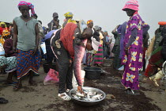
GENDER BARRIERS TO INTERNATIONAL AGRIFOOD TRADE
Agrifood trade is a promising opportunity for women-led SMES in developing countries.
Women-led SMEs largely operate in the lower value-added value chains at the small-scale level in the informal sector.
Access to markets constrained by high trade costs: tariffs, transport costs, documentation procedures, delays at the border and compliance with standards.
Non-tariff measures (NTMs), such as sanitary and phytosanitary measures and technical barriers to trade, can act as barriers to trade and be primary constraints to trade in agriculture for SMEs (both women- and men-led ones).
Women- led SMEs have competitive disadvantages compared to men-led ones. Women face additional gender-specific barriers and gaps, such as:
  Finance gap. Limited access to credit; difficult to bear the export costs; higher risks of business failure.
  Technology/digital technology. Insufficient capacity to produce high-quality products and meet standards; limited access to digital trade and online trade facilitation services.
  Literacy and skills gap. Low literacy, entrepreneurial and leadership skills. difficulty handling customs procedures.
  Other normative, sociocultural, policy barriers. Gender-discriminatory laws and norms; low bargaining power, social capital; poor business networks; mobility constraints; harassment and abusive practices; gender-blind trade-related facilities and infrastructures; limited representation in stakeholder organizations.
© FAO/Sylvain Cherkaoui

Slide 10
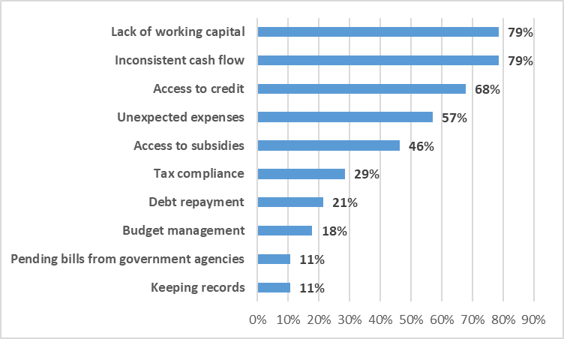
WOMEN-LED MSMEs IN THE AGRIFOOD SECTOR IN KENYA (1)
In Kenya, a pilot survey on women-led MSMEs in the agrifood sector was conducted in 2022 with the aim to investigate business challenges in markets and trade and the policy needs of women owners and/or managers of enterprises.
Preliminary findings*
Major business challenges regard financial constraints, difficult recovery from the COVID-19 pandemic, taxation, market competition.
Gender-related barriers are found in the financial service area, business relationships, marketing and trade.
3. Financial issues faced by surveyed women entrepreneurs
The majority of respondents (67 percent) tried to obtain credit at least once in their life, but failed.
70% of respondents believe that women have more difficulties than men in accessing subsidies due to gender-discriminatory practices.
4. Reasons for credit denial
20% of women reported to have experienced harassment and 25 % sexual harassment in their business activities.
n=44
*Study not yet published - under internal review

Slide 11
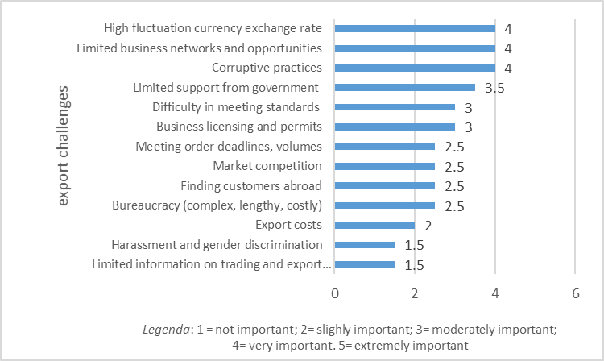
WOMEN-LED MSMEs IN THE AGRIFOOD SECTOR IN KENYA (2)
5. Reasons for not exporting
6. Export challenges
7. Most important areas for policy support
Financial assistance | Business development services | Capacity development | Access to technology | Gender sensitive laws and policies | Logistics, transports, infrastructures | Safety nets and social support | Technical assistance with standards | Trade facilitation and export promotion
2.27 | 2.41 | 4.09 | 4.36 | 4.45 | 5.95 | 6.86 | 7.18 | 7.41
Ranking scale 1-9 where #1 is the most important and #9 least important area for policy interventions.

Slide 12
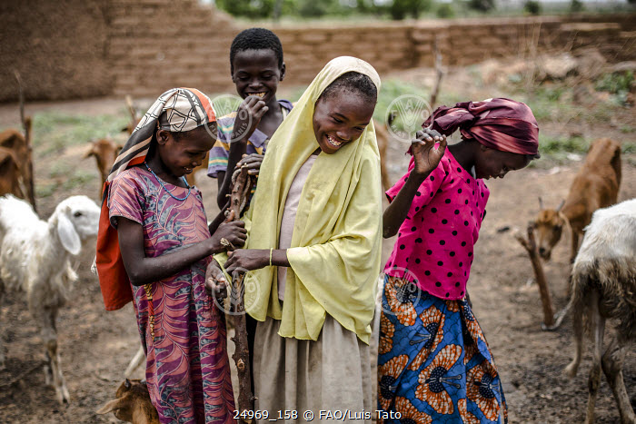
WRAP-UP AND WAY FORWARD
WRAP-UP
Building inclusive, sustainable and resilient agrifood systems requires addressing inequalities that affect the agriculture sector performance.
Gender inequalities prevent many women from accessing agrifood markets and reaping the full benefits of trade.
Trade gains are not automatically equally redistributed. There is the need for gender-responsive policy interventions across all relevant sectors.
Gender-responsive agricultural and trade policies can promote an inclusive market-led transformation of the agricultural sector, by removing gender barriers to domestic and international trade and creating an enabling business and policy environment conducive to gender equality and women’s empowerment.
WAY FORWARD
Strengthen countries’ capacity to systematically integrate gender equality concerns in policies, programmes and strategies.
Promote multi-stakeholder partnerships, policy dialogues, sharing of best practices, gender awareness raising initiatives.
Develop gender analysis and collect gender-disaggregated data.
Provide capacity building and technical assistance for women traders and entrepreneurs in both the formal and informal sector.
Incorporate and implement gender provisions in trade agreements in regional and national programmes.

Slide 13


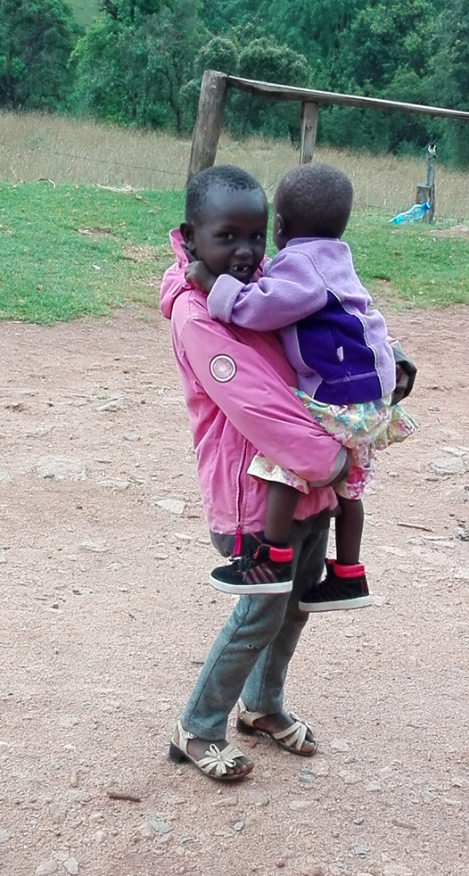

Thank you!

