Slide 1
Economics of COVID-19
Thinking ahead with history (and geography) in mind
Paolo Paesani
Department of Economics and Finance
MESCI – MUNDUS

Slide 2
Introduction
Goal
  Reflect on the Economics of COVID-19, putting the current pandemic in historical and geographic perspective
  Target audience: YOU (MESCI – MUNDUS students)
  Speaker: Me (Keynesian economist and Teacher of History of Economic Thought and Economic policy)
Structure
  Message 1: Good time to be studying development economics and international cooperation.
  Message 2: «This time is truly different!» … True but …
  Message 3: Doctor Keynes: Economic theory in a diagnostic scene

Slide 3
Message 1
Governments and central banks are pursuing unprecedented measures to mitigate the global downturn, lest a now-certain global recession gives way to a depression (already an uncomfortably high risk). As they do, we will likely see a further erosion of the distinction between mainstream economics in advanced economies and in developing economies. […]
All the issues raised above are ripe for more economic research. In pursuing these avenues of inquiry, many researchers in advanced economies will find themselves inevitably rubbing up against development economics – from crisis management and market failures to overcoming adjustment fatigue and putting in place better foundations for structurally sound, sustainable, and inclusive growth. Insofar as they adopt insights from both domains, economics will be better for it. Until recently, the profession has been far too resistant to eliminating artificial distinctions, let alone embracing a more multidisciplinary approach.
Source El-Arian (2020)

Slide 4
Reflecting on message 1
The world is facing the (partial) disruption of global supply chains and (temporary) collapse of aggregate demand. This will have short, medium and long-run effects on people’s lives, habits, savings, jobs, which are extremely hard to predict at the moment (too much uncertainty).
The policies that governments and central banks are implementing will cushion the economic impact of COVID-19 but «rich» countries will face, at least for some months to come, the kind of disruption and painful adjustment that developing countries have been experiencing for decades on a larger scale (often without the means to fight them that developed countries can deploy).
  Extreme volatility (financial markets, GDP, prices)
  Market failures (Externalities, lack of public goods, inequality)
  Adjustment fatigue and above all personal insecurity
Good time to be studying development economics and international cooperation!

Slide 5
Message 2
«Not since the 1930s have advanced and emerging economies experienced the combination of a breakdown in global trade, depressed global commodity prices, and a synchronous economic downturn. True, the origins of the current shock are vastly different, as is the policy response. But the lockdown and distancing policies that are saving lives also carry an enormous economic cost. A health emergency can evolve into a financial crisis. Clearly, this is a “whatever-it-takes” moment for large-scale, outside-the-box fiscal and monetary policies».
Source: Reinhart (2020)

Slide 6
Reflecting on message 2
Reinhart remind us that we have not experienced anything like to COVID-19 in recent decades and the world might indeed plunge into a new Great Depression, more difficult to handle than the last global financial crises …
True, but … do not forget to put things in perspective (History and Geography matter!)

Slide 7
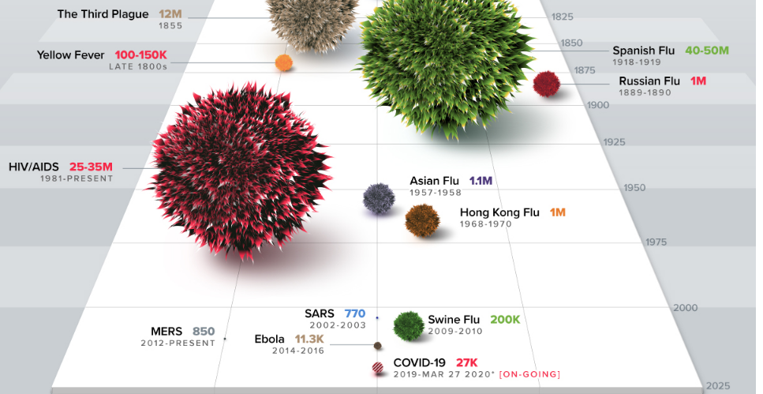
Source: https://www.visualcapitalist.com/history-of-pandemics-deadliest/

Slide 8
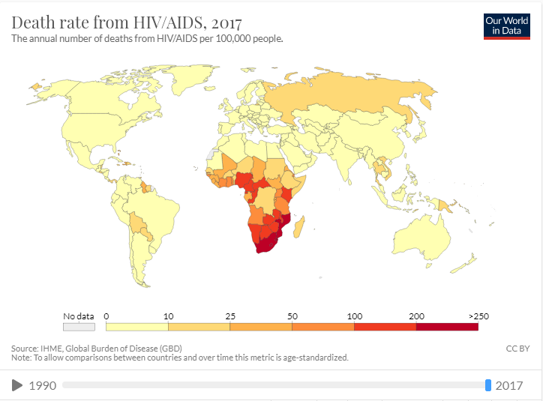
Source:https://ourworldindata.org/hiv-aids

Slide 9
Reflecting on message 2
I am not minimizing COVID-19 but please remember …
  Pandemics often spread through commerce and in this sense are man-made (differently from earthquakes or floods). As men cannot do without commerce …
  The world has faced pandemics and fought them in the past (progress in science and medicine and public health care in the XX century)
  «Out of sight, out of mind» pandemics (Clearly, not out of your sight!)
  Developed nations are facing today something vaguely similar to what millions of people in developing countries have been experiencing for decades (paralizing insecurity and fear, economic and personal, including fear that if you are seriously ill there is no public hospital that will take care of you).
The real difference between COVID-19 and the past is the «Globalization of fear».
What lessons can we learn from this?

Slide 10
Reflecting on message 2
Lessons to be learnt in times of Global fear
  Public health care is essential and should be preserved from government budget cuts (More generally the «State» matters and can save your life).
  Border controls do not stop viruses (unlike goods and people)
  Global problems require Global governance. This means global institutions designed to act in the interest of all parties concerned, National willingness to cooperate with global institutions, share knowledge and solutions, help out each other, COMPLEXITY and the need for guiding principles (Guzman 2020).
Will these lessons be learnt? Hard to say at the moment.
  It will depend on the extent and severity of the current crisis. The longer COVID-19 lasts, the worse its effects are

Slide 11
Coming out of the box ….
As COVID-19 makes eveything worse (including «out of sight» pandemics), this makes it even more urgent to bridge the gap between mainstream economics for advanced countries and developing economics and to intervene with large-scale, outside-the-box fiscal and monetary policies.
Outside-the-box? What box exactly? How to do it?

Slide 12
Message 3
Looking for specialists in out-of-the box remedies?
Doctor Keynes is the man!
J.M. Keynes (1883 – 1946)
Why Keynes? Why now?
  Keynes’s economics (diagnosis) as a basis for policy (cure) in a world plagued by uncertainty (Hoover 2006)
  Purpose of Keynesian policies: Find solutions to current-day problems and carry forward the progress of mankind.
  Humanism and love of variety
  Global scope and mutual interest

Slide 13
Reflecting on message 3
In 1923 Keynes wrote: «Economists set themselves too easy, too useless a task if in tempestuous seasons they can only tell us that when the storm is long past the ocean is flat again».
This spirit never left him.
Economists must come up with viable solutions to current problems, interveninig whenever the “market” left to itself offers no quick and social sustainable solution.
Three examples of Keynes’s approach to pressing economic problems:
  The General Theory (1936) and the problem of mass unemployment in the wake of the Great Depressions.
  How to pay for the war (1940) and the problem of financing Britain’s war effort avoiding inflation and a fiscal/financial crisis.
  The International Clearing Union (1944) and the problem of reorganizing the international monetary system after WWII.

Slide 14
Reflecting on message 3
In November 2008, in the midst of the global financial crisis, Robert Lucas, one of the «high priests» of mainstream economics against Keynes (rational expectations, competition as a guarantee of efficiency, austerity and price stability) claimed «We are all Keynesians in the fox-hole»!
Even F. von Hayek, the staunchest supporter of free markets and individualism, claimedm in the itroduction of his Road to Serfdom
«Individual freedom cannot be reconciled with the supremacy of one single purpose to which the whole of society is permanently subordinated.
To a limited extent we ourselves experience this fact in wartime, when subordination of almost everything to the immediate and pressing need is the price at which we preserve our freedom in the long run. The fashionable phrases about doing for the purposes of peace what we have learned to do for the purposes of war are completely misleading, for it is sensible temporarily to sacrifice freedom in order to make it more secure in the future, but it is quite a different thing to sacrifice liberty permanently».

Slide 15
Reflecting on message 3
In times of crisis (the COVID-19 fox-hole), Keynes ideas and spirit come back into fashion, only to be forgotten again when the crisis is over.
Keynes and the «Return of the Master» (https://www.youtube.com/watch?v=8R1lEVY5T_c)
A good example of how the «Return of Keynes» looks like today among mainstream economists can be found here https://voxeu.org/content/mitigating-covid-economic-crisis-act-fast-and-do-whatever-it-takes

Slide 16
Conclusions
Global problems, global solutions
  Requires courage, far-sightedness, a global vision and appeal to self-interest (if not generosity)
  The spirit of Keynes (and some of his tips) can help to find solutions
  Are we there yet? Probably not!
    Keynesian instruments are being put in place but the spirit is not there yet
    Threats: The scourge of nationalism.
  Will we get there?
    History suggests that we will (in the end) …
    SCIENCE without borders AND THE INTERNET will get us there (hopefully)

Slide 17
Keep going and stay safe!

Slide 18
Reference
El-Arian M.A. (2020), «The Race Between Economics and COVID-19», 23 March 2020 https://www.project-syndicate.org/commentary/covid19-will-change-economics-three-ways-by-mohamed-a-el-erian-2020-03
Guzman M (2020), «Five principles for the pandemic», 27 March 2020 https://www.project-syndicate.org/commentary/covid19-principles-for-responding-by-martin-guzman-2020-03
Hoover K. (2006), «Doctor Keynes: economic theory in a diagnostic science», in Backhouse R.E. and Bateman B.R. (eds), The Cambridge Companion to Keynes, Cambridge University Press, Cambridge
Reinhart C.M. (2020), «This time is truly different», 23 March 2020, https://www.project-syndicate.org/commentary/covid19-crisis-has-no-economic-precedent-by-carmen-reinhart-2020-03

