Slide 1
SUSTAINABLE DEVELOPMENT AND RURAL CHANGE
David Suttie

Slide 2
Some definitions of sustainable development
“Maintaining development over time” (Elliot 2006)
Development that “can continue into the future without detriment to either people or their environment” (Morse 2010)
“Development that meets the need of the present without compromising the ability of future generations to meet their own needs” (WCED 1987)
Development that is “ecological as well as economically and socially sound” (IUCN 1980)
“Development that is both people-centred, concentrating on improving the human condition, and conservation based, maintaining the variety and productivity of nature” (IUCN 1991)
“Sustainable development is equitable development since development that is not equitable is not sustainable in the long-term” (Statement to IUCN General Assembly, 1991, cited in Adams 2009).

Slide 3
Key principles
Three dimensions of development
Economic
Environmental
Inter-generational equity
Retention of natural capital
Question: can natural capital be substituted for human capital?
Intra-generational equity
Ensure basic needs of all
Reduce inequality
Social
Question: are trade-offs acceptable (e.g. economic can compensate for social or environmental losses)?
Question: must all people benefit at all times? Can losses by some be compensated by the gains of many?

Slide 4
Multiple definitions and interpretations
Many definitions, interpretations and meanings
  Estimated that more than 70 definitions had been used by early 1990s (Elliot 2006)
Term “sustainable” widely used and often associated with other terms
  E.g. sustainable agriculture, sustainable cities, sustainable growth, sustainable lifestyles, sustainable transport etc.
Definitions express different ideas and perspectives about relationship of environment to society
  Is it possible to define such a broad, overarching term?
At highest level, definitions general, aspirational and all-encompassing

Slide 5
Critical questions
Is the concept so vague as to be useless in practice?
How to measure?
Who decides on priorities?
  Which geographic scale to use
  Transboundary issues
  Conflicts between groups
How to distinguish between needs and wants?
How far to extend obligations?
How much capital depletion (and of what type) is acceptable?
Does the natural world have intrinsic value?
What about ethics? Which framework to use?

Slide 6
Who gets to decide what is right? On which basis?
Ideas on what constitutes sustainable development may be contested and subject to debate.
  How do we measure sustainable development?
  What are the causes of global poverty? How are these causes best addressed? By aid?
What criteria to assess ethics of decisions related to environment and development?
  Human rights principles?
  Utilitarianism?
  Justice?
  Virtues?

Slide 7
Critiques of sustainable development
Justifying business as usual
  Required balance between economic, social and environmental concerns allows justification of activities if social and economic benefits are argued to outweigh environmental costs
“Greenwashing”
  Broadness and multiplicity of definitions allows use of term to “greenwash” activities that are not sustainable
Maintains dominant Western paradigm
  Mainstream sustainable development involves little change in the dominant mode of development which emphasizes consumerism, large-scale production and economic growth
  Ignores possibility that dominant Western models of development have contributed to global problems of environmental degradation, climate change, poverty and inequality
Generating debate and scrutiny
  Wide use of term embeds need for sustainability in public consciousness, creates expectations, incentives and scrutiny for organisations to demonstrate sustainability principles in their activities (Daley 2015)

Slide 8
Typologies of sustainable development (1)
Radical
Very strong
Very weak
Mainstream
Weak
SDGs

Slide 9
Typologies of sustainable development (2)
Mainstream (weak) sustainable development
  Seeks continual economic growth and planetary environment of permanently high quality
  Reconciles Western values of industrialisation, modernisation and economic growth with need to preserve natural environment (Adams 2009)
  Reformist rather than radical, aiming to improve existing structures rather than demanding that they be dramatically rethought and restructured
  Trusts Western-based science models to find solutions to problems
  Key ideas include market environmentalism, ecological modernisation and environmental populism
  Anthropocentric perspective: natural environment understood in terms of value to human economies and societies

Slide 10
Typologies of sustainable development (3)
Very weak forms
  Substitutability between natural and human capital
  Insisting on strong forms of environmental preservation could hinder development and lead to the persistence of poverty and social instability
  Focus on scale of economy (GDP) and other economic indicators as measures of development
  Anthropocentric perspective
  Continual growth based on exploitation of resources desirable and facilitated by free markets
  Innovation and technological advances to solve problems associated with pollution and resource scarcity

Slide 11
Typologies of sustainable development (4)
Very strong forms
  Environmental preservation seen as precondition for sustainable growth (relationship other way around under weak forms)
  Overall levels of natural capital should not decline
  Requires fundamental changes to economic, political and social structures
  Anthropocentric perspective: natural environment has inherent value
  Very strong forms generally call for decrease in scale of economy and is opposed to some forms of development
  Questions overall development narratives

Slide 12
Alternative perspectives (1)
Circular economy
Green political thought
Eco-feminism
Political ecology
De-growth
Deep ecology

Slide 13
Alternative perspectives (2)
Green political thought
  Critical of Western model of industrial development, individualism, consumerism and modernism
  Call for endogenous development based on free choices of local people and withdrawal from modern capitalist economy
  Unit of development is culturally defined local group, not nation state
Deep ecology
  Rejects anthropocentrism, according all living species equal value
  Sees humans as part of nature
  Invites each person to develop personal values and system of relating to nature
Eco-feminism
  Based around belief that women and nature are dominated by men and the need to establish more equitable relations
  Explores topics such as: role of women in environmental management; importance of gender in understanding political economy; gender divisions of work

Slide 14
Alternative perspectives (3)
Political ecology
  Focus attention on reality that decisions about hum-nature relations are political and involve exercise of power
  Argues that political and environmental conditions are interrelated
  Focus on role of state in promoting and legitimising particular understandings and use of environment
  Highlights how power is reflected in: domination of humans by humans; domination of nature by humans; the way people relate to and understand the environment
  Critical of the way states undertake development
Circular economy
  Propose new type of industrial economy in which reuse and recycling of materials is central feature
  All waste reused therefore contrasts sharply with linear economy based around “take, make, dispose” (Ellen MacArthur Foundation 2013)
  When products can no longer be used for intended function, recovery and recycling occurs; products and materials are regenerated at end of each service life

Slide 15
No easy solutions
Political
Global democracy?
Green socialism?
Economic
Reform markets?
New ways of measuring well-being?
Social
Change mindsets?
Emphasize equity – between humans (and non-humans?)?

Slide 16
Rural development and the sustainable development agenda
Agriculture central to eradication of hunger and poverty
  Most poor and hungry people live in rural areas
  Pro-poor nature of agricultural growth (e.g. World Bank 2008)
Renewed focus on agriculture in recent years
  Food price crises
  Demand for agricultural products projected to increase by 50-60% by 2050
Rural people are custodians of natural resources, diversity and central to efforts to mitigate and adapt to climate change
Central to equity agenda as most poor people are rural
  Evidence that more equal societies develop faster and more sustainably
  4/5 of the world’s very poor people are rural (World Bank, 2018)
  A significant proportion of the urban poor are rural migrants
Interdependence of rural and urban livelihoods
  Green energy , water systems and air quality all intimately related to rural sphere
  Blurring divide between urban and rural areas
  Migration/mobility between rural and urban areas
Increased productivity and incomes of small farmers indispensable part of development process
  Productivity advantages of small-scale farming (FAO and OECD, 2012; Wiggins, 2009)
  Structural transformation begins in small-scale agriculture (Lipton, 2005; World Bank, 2008)

Slide 17
Counter narrative: urbanization
Urban migration
Youth are leaving rural areas
Economies of scale
Cities offer economies of scale and agglomeration benefits
Historical pathways
All historical development pathways have involved urbanization

Slide 18
Features of rural areas
Economic
Diseconomies of scale
Higher rates of poverty and hunger
Environmental
Locations of richest biodiversity
Vulnerable to climate change/weather shocks
Social
Often limited democratic participation
Distinct traditional social systems/kinship
Seasonality of income and prominence of own-consumption
Reliance on natural resource-based activities
Out-migration

Slide 19
Relevance of development debates to rural areas (1)
Framing of development debates influences how poor rural people are engaged in development initiatives and policies
Post World War II: focus on growth (see Lewis, 1954 and Rostow, 1960)
  Collier and Easterly still advocate for centrality of growth
1960s, modernisation models: structural development through education and transfer of technology and institutions
  Criticized for failing to consider unequal relationship between developed and developing countries

Slide 20
Relevance of development debates to rural areas (2)
1970s & ‘80s, neo-liberalism and structural adjustment policies led by WB, IMF and New Right movement in US and UK
  Emphasised role of market and need to reduce scope of public sector
  Largely failed to bring about reductions in poverty
  Remains influential today though recognition of need for balance between market, state and other forms of organisation

Slide 21
Relevance of development debates to rural areas (3)
1990s and 2000s: Millennium Declaration, inclusive development, participatory approaches
  Recognition of failure of trickle-down approaches
  Recognition of heterogeneity of poor people
  Focus on vulnerable and disadvantaged groups
  Focus on sustainability but little meaningful action yet
  Issue of inequality, between and within countries is reemerging, in post 2015 agenda and could have implications on the need to prioritize rural development

Slide 22
Focus on inclusivity
Inclusivity emerging as major theme
  Shift in focus from poverty reduction towards ensuring no one is left behind as economies develop and transform
Insufficient evidence on relationship between growth and inequality, however important to consider the number of ways the former can increase the latter
  Biases in productivity gains: If initial distribution of productive assets (capital, land, skills) skewed towards wealthy, growth likely to be “pro-rich”
  Biases in investment: lack of savings for poor to invest; political influence of urban elite; transaction costs and risks of investing in poor rural areas
Inequality can reasonably be expected to constrain growth through several channels
  Social instability
  Demand linkages (poor contribute little to effective demand)
  Promote savings and investment (poor cannot save while investments by elite may not further national interest)
  Evidence that poor have more children, creating population pressures on growth in per capita income

Slide 23
Counter narrative
Arguments for inclusivity create a compelling case for policies and investments to prioritize agriculture and rural areas, but:
  Growth is normally associated with poverty reduction and it is the absence of growth, not the type, which is the biggest challenge to overcome (Collier 2007)
  Easterly (2002) cites evidence relating economic growth with poverty reduction, and economic stagnation/recessions with rising poverty
  Collier (2008):Investment in rural development and smallholder farmers driven by misguided and romantic notions representing opposition to large, hierarchical, pressurized organisations where developed middle classes work
Overall: Initial conditions key determinant of inclusiveness of growth
  Policies also key in shaping evolution of inclusive growth: focus on labour intensive sectors? invest in areas where poor are concentrated? focus on extractive industries?

Slide 24
Key debates in rural development (1)
Migration:
  Mainstream narrative – counter migration flows by combatting root causes in destination countries/communities
  Counter narrative – facilatate/enable migration as it is a key coping strategy for poor households (Suttie & Vargas-Lundius 2016).
Smallholder farming
  Mainstream narrative – mixed according to region, focus on productivity gains of large-scale farming among some LA and SSA countries, in Asia recognition of key role smallholders have played in structural transformation
  Evidence shows higher labour productivity on small farms and high agricultural growth rates in countries whose agriculture sector are dominated by small farms (e.g. Burkina Faso, Ghana, Niger) (Wiggins 2009)
Role of private investment
  Mainstream narrative – ODA model is outdated, private flows larger, associated with greater innovative, transformative potential, public private partnerships successful in some cases.
  Counter narrative – irresponsible private investments driver of many development problems and forms of economic exclusion, public private partnerships only reach “ better-off” poor, much unrealized potential in domestic resource mobilization.

Slide 25
Key debates in rural development (2)
Urbanization:
  Mainstream narrative: urbanization is proceeding faster than ever before, economies of scale and cluster advantages of cities offer greatest potential to industrialize and achieve widespread reduction in poverty.
  Counter narrative: urbanization which is not underpinned bythriving agriculture and rural sectors may not be sustainable and asscociated with food security issues, spiralling migration and spacial inequaties.
Development pathways:
  Intestification of agriculture, movement to capital intensive farming, commercialization key for structural transformation, economic growth and modernization.
  Counter narrative: Current environment and climatic challenges, as well as global trade situation make traditional pathways obsolete for today’s low-income countries.

Slide 26
Challenges to be addressed
Declining natural resource bases (e.g. soil erosion)
Human capital
  Underinvestment in rural education
  Difficulties in providing adequate rural health services
Missing infrastructure
  Difficult for rural people to access markets
  Poor information flows to and from rural areas
  Heavy household workloads
Lack of rural financial services
Technology not adapted to small-scale farming
  Poor incentives for smallholders to invest in technology
Policy and investment frameworks skewed to large-scale corporate farming models (Vorley et al, 2012)
Entrenched gender biases/discrimination
Entrenched power imbalances

Slide 27
Natural resource degradation
Tragedy of the commons (Hardin 1968)
Need to assess different land ownership options:
  State
  Private
  Open access
  Collective/community management
In some contexts, land scarcity raises the question of farming existing land more intensively
Some sustainable practices have shown promise
  Zero-till agriculture
  Crop rotation
  Integrated pest management
  Natural energy sources (solar, biogas)
  Different land ownership regimes (privatisation, community groups etc.)
  But these are not always applicable and not always easy to externally impose

Slide 28
Infrastructure
Economies of scale make it costly to provide in sparsely populated rural areas
Often least useful (especially for poor people) forms of infrastructure are prioritized (motorways, airports etc.)
Under allocation of budget on maintenance
Public private partnerships show some promise in some cases; introduction of competition in provision and maintenance of services is growing
Need to involve local people in design, provision and management
Territorial planning offers a new way of looking at challenges

Slide 29
Rural financial services
Rural people require range of products, including loans, savings and insurance
High transaction costs for private operators in rural areas and criticisms of inefficiency of public operations
Adverse selection where interest rates high
Lack of collateral for rural people (especially women)
Some approaches that have shown promise
  Savings groups
  Public private partnerships
  Guarantee schemes
  Linking with training
  Targeting women
  Working within local informal systems

Slide 30
Rural education
Large rural-urban gaps persist in education participation and achievement, even in country’s making strong progress in expanding enrolment
Specific barriers constraining rural children’s education include:
  Lack of transport infrastructure and large distances
  Financial costs (despite fee abolishment in some countries)
  Poor health and nutrition
  Opportunity costs of forgoing children’s work at home/farm
  Language and culture issues
  Gender issues in enrolment, curricula and facilities
  Quality deficits in rural schooling
Lack of relevant vocational training
  Existing systems often poorly linked to labour market needs
  Do not always reach those most vulnerable (e.g. youth, women farmers)
Many complementary responses needed
  Reduce associated costs
  Conditional social protection
  Girl-friendly school environments and facilities
  Training and retention incentives for rural teachers
  Involve local stakeholders in education planning (scheduling, curricula etc.)

Slide 31
Power imbalances
Global trade regimes skewed towards developed countries, especially in food and agriculture sectors
Global political bodies controlled disproportionately by developed countries
Wealthy private companies and individuals with growing power in shaping development agendas
Rural-urban inequalities
Inequalities in ownership and control of productive assets
Gender inequalities

Slide 32
Looking inside the household
Children
  Child labour
  Girls: large time spent on household tasks
  Boys: hazardous work
Youth
  Lack of decent employment
  Difficulty accessing land, finance and markets
Women
  Lack of decision-making power
  Lack of control of resources
  Traditional constraints on activities
  Lack of access to productive resources, including land
Men
  Machismo culture
  Alcoholism

Slide 33
Some implications
How to reach poorest?
  Invest in sectors where they work
  Prioritize job-rich growth
  Address biases in trade and investment policy
Address power imbalances in food and agricultural systems
Reorient research and development towards small-scale agriculture
Reconsider public provision of services and infrastructure
New forms of partnership but need to ensure rural people’s interests are represented
  Public-private-producer partnerships
Greater role of farmers’ organisations
Invest in rural primary and secondary education
  Encourage girls’ education
  Address relevant issues in curricula
  Create incentives for rural teachers
  Link with vocational training and job market
Finance climate adaptation for most vulnerable, especially by countries who are most responsible for – and have benefited from – past emissions
Address gender inequalities through education, initiatives targeted at improving women’s control over resources and access to markets, and engaging with women’s groups
Improve rural-urban linkages
Manage risks of migration and exploit potential
Working with local groups in a sensitive and respectful way

Slide 34
Climate change threats to sustainable development
Climate change represents a fundamental threat to current development trajectories as it is clear that development which involves large-scale emissions of greenhouse gases is not sustainable
Substantial changes in climate undermine natural and economic systems (e.g. water supplies, food systems, infrastructure, health)
Considerable uncertainty in predicting extent of future climate change and impacts. Increasingly clear that scale of impacts will be large and likely to set back many past development gains.
  Impacts on poor people and less developed regions potentially serious.

Slide 35
Rural dimensions of climate change
Rural people often rely heavily on natural resources and natural processes for their livelihoods.
Changing temperatures and precipitation patterns impact upon agricultural productivity.
Increased incidence of extreme weather events (droughts, tropical storms etc.) add yet more risk and uncertainty to agricultural systems.
Sea level increases, coastal erosion, ocean acidification threaten the sustainability of fishing communities.

Slide 36
Features of climate change problem (1)
Possibility of downward spirals of increased waste and depletion of renewable resources.
  Excessive quantities of waste (GHGs) damage renewable resources, leading to changes in ecosystems, which undermines the ability of natural systems to regulate climate system.
Massive scale of problem
  Massive quantities of GHGs produced globally (7.8 billion tonnes from burning fossil fuels in 2005 [Houghton 2009 p.40]).
  Costs of reducing GHGs extremely large, but
  Costs of climate change impact due to failing to reduce GHGs even larger.
Spatial difficulties
  Emission of GHGs dispersed, as are impacts of resulting climate change, but
  No link between responsibility for GHG emission and negative consequences via climate change (in fact, those most responsible generally suffer least).

Slide 37
Features of climate change problem (2)
  Slow but permanent onset of climate change, resulting from the long-term stability of major GHGs in the atmosphere, brings about certain temporal issues
    Disconnect between current GHG emissions and future impacts and, consequently
    Climate change impacts from current GHG emissions will not be experienced by people alive today.
  Climate change is hugely complex and involves much uncertainty
    Multiple variables and non-linear relationships across disciplines
    Uncertainty about interactions between climate systems and with other systems, as well as about how human behaviour will change in the future.

Slide 38
Climate science (1)
As radiation from the sun passes through the atmosphere to the earth’s surface, several processes determine how much heat remains
  Some incoming solar radiation is absorbed by the atmosphere’s stratospheric ozone, while some is reflected back into space by substances in the ozone that are reflective (e.g. aerosol particles)
  The remaining radiation passes through to the earth’s surface but may be reflected back into space by reflective surfaces (e.g. ice, snow)
  Radiation absorbed by the earth’s surface is re-emitted at a longer wavelength in the form of heat.
Greenhouse effect: because outgoing radiation has a greater wavelength than incoming solar radiation, relatively more of it is absorbed by the atmosphere.
  In addition, the existence of GHGs in the atmosphere means relatively more outgoing radiation is retained in the atmosphere.
Anthropogenic activities – burning of fossil fuels, deforestation, agriculture, - contribute to GHGs in the atmosphere.

Slide 39
Climate science (2)
Climate system involves complex interaction of multiple constituent systems – the ocean, forest, cryosphere, biosphere etc. – which lead to various feedback mechanisms
  E.g. 1. increased temperature raises evaporation, in turn exacerbating greenhouse effect (water vapour is a GHG)
  E.g. 2. increased temperature leads to melting of ice, reducing reflectivity of earth’s surface (albedo)
  E.g. 3. increased temperature leads to greater incidence of forest fires, meaning more carbon dioxide (CO2) in atmosphere.
Possibility of tipping points, where feedback effects reinforce each other, making return to original position impossible.

Slide 40
Climate science (3)
The most important causes of anthropogenic climate change is the accumulation of GHGs in the atmosphere, especially CO2
  Human activities release GHGs into atmosphere (e.g. burning fossil fuels)
  Human activities lead to a reduction in the rate at which GHGs are absorbed from the atmosphere (e.g. deforestation)

Slide 41
Evidence of climate change (1)
Arguments on anthropogenic climate change centre on evidence of nature and extent of climate change, and empirical explanations for observed changes (Cherni et al. 2015).
The warming of the climate system is acknowledged and unequivocal.
  Global average air and temperature increases observed since mid-1900s (figures from Richardson et al. 2009, p9)

Slide 42
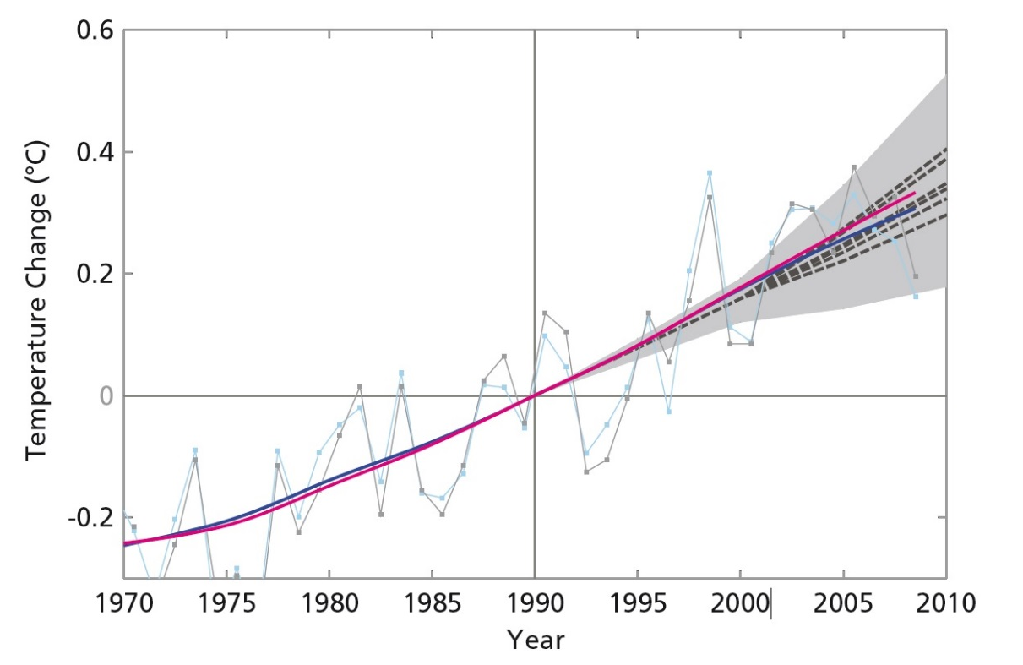
Evidence of climate change (2)

Slide 43
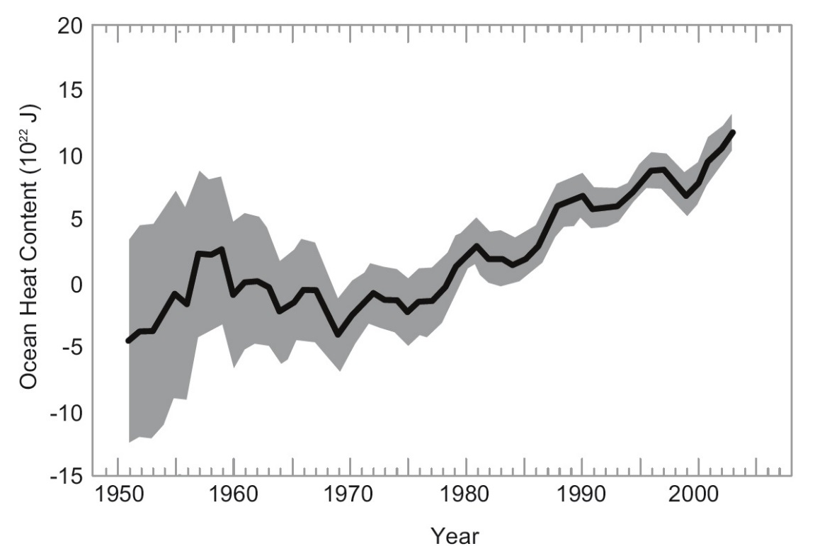
Evidence of climate change (3)

Slide 44
Attributing climate change (1)
Effects of different climate change drivers assessed by using climate system models to examine effects of different climate forcings.
Models from IPCC (2007) show predicted changes when allowing for natural and anthropogenic forcings (models on next slide).
Models provide strong indication that majority of recent temperature rises may be attributed to anthropogenic forcings
  Observed patterns of climate change cannot be reproduced in models if anthropogenic influences are excluded
IPCC (2013) suggests there is a confidence level of 95% that global climate change is anthropogenically caused due to excessive GHG emissions.

Slide 45
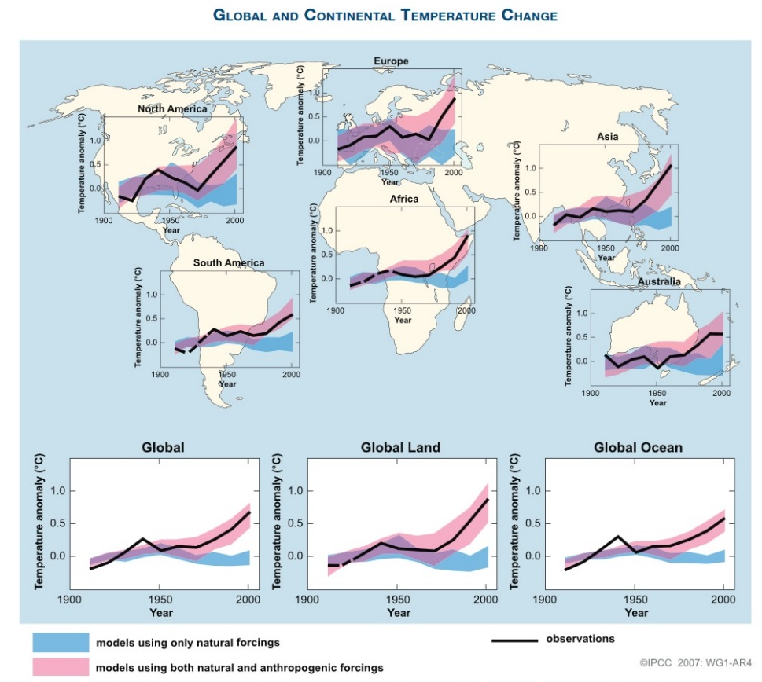
Attributing climate change (2)

Slide 46
Expected and observed effects
Main effects which are expected – and have been observed – are melting of snow and ice and rises in global average sea level (IPCC 2013)
  Changes in frequency and amount of precipitation
  Occurrence of extreme weather events increased, especially extreme heat events
  Intense tropical cyclone activity has probably increased, especially in North Atlantic.

Slide 47
Policy challenges (1)
Policy challenges in addressing climate change are well represented by Hardin’s Tragedy of the Commons model (Hardin 1968).
  Unless all act in a coherent and consistent manner, there is no incentive for anyone to act.
Variety of challenges in agreeing on international climate change policies, including:
  Disagreement over causes
  Uncertainty on nature, degree and effects
  Differentiation in local impacts
  Special interest groups within and among nations (e.g. oil firms)
  Nature of existing political systems and relationships (Cherni et al. 2015).

Slide 48
Policy challenges (2)
Difficulties lead to diverse incentives and concerns among different countries, such as:
  Governments and citizens not wanting to bear costs of GHG emissions reductions
  Fears that countries with higher emissions allowance will gain competitive trade advantages
  Industrialized countries facing high adjustment costs to reduce GHG emissions
  Developing countries with relatively low emissions per capita not wanting to be denied development/growth opportunities
  Developing countries needing financial and technical assistance to adapt to climate change impacts – and looking to developed countries for this.
Differences in perspectives shaped by awareness that developed countries are major GHG emitters, benefit from high emission lifestyles and are least vulnerable to impacts of climate change (Cherni et al. 2015).

Slide 49
Policy options
Climate change policies fall into two broad categories:
  Mitigation: reducing the causes of climate change, in particular, reducing emissions of greenhouse gases. Historically, CO2 emissions have been associated with processes of industrialisation and, as such, mitigation efforts have been concentrated in industrialised countries.
  Adaptation: reducing the effects of climate change, ie helping peoples and nations respond to the changes brought about by climate change. Developing countries are likely to be those most affected and their situation is further compounded by their lack of resources to deal with those changes (Cherni et al. 2015).

Slide 50
Climate change ethics
Climate change is a profoundly ethical issue as it involves the actions of some people seriously harming the interests of other people (Cherni et al. 2015).
Anthropogenic climate change is caused by the welfare-maximising actions of some people, which in turn causes harm to different people (such as poor people in vulnerable locations in developing countries)
  Asymmetries in the distribution of benefits and harms (Cherni et al. 2015).
Raises questions about rights (to pursue certain lifestyles) and duties (to protect those vulnerable to climate change impacts).
Strong basis for development and climate policies to be driven by ethical considerations, but
  Little indication of ethical role in national or international responses to climate change (Cherni et al 2015).
Ethical complexities due to uncertainty about causes and effects, temporal and spacial differences and ethical disagreements
  Difficult to connect climate impacts associated with different actions, assign rights and obligations and assess ethics of different actions (Cherni et al. 2015).
Governance systems – national and international – reflect interests and ethical perspectives of the powerful.

Slide 51
Economic methodological difficulties
Traditional approaches to cost-benefit analysis ineffective because:
  Uncertainty associated with climate projections and impacts
  Difficult to value impacts (how to value loss of life, loss of nature, loss of lifestyles?)
  Valuing risks problematic due to uncertainties as well as possibility of catastrophic consequences
  Choice of discount rates difficult due to generational and distributional conflicts.

Slide 52
Paris Dec 2015: A triumph?
Many have enthusiastically welcomed the Paris Agreement. It included commitment to:
  Hold the increase in the global average temperature to well below 2°C above pre-industrial levels and to pursue efforts to limit the temperature increase to 1.5°C above pre-industrial levels
  Increase the global ability to adapt to the adverse impacts of climate change and foster climate resilience and low greenhouse gas emissions development
  Make finance flows consistent with a pathway towards low greenhouse gas emissions and climate-resilient development
But there was much scepticism, for example:
  There was doubt that the target of 1.5°C was still possible, there was no scientific basis to GHG emissions reduction pledges and these pledges are voluntary (not legally binding)
  No clear timescale for phasing out of fossil fuels
  Emission reduction pledges based on development of low-emitting technologies
  Principle of Common but Differentiated Responsibilities was watered down and the requirement that human rights be taken into account was removed from the text

Slide 53
The role of institutions (1)
Institutions are the rules and organizations that govern interactions between humans and with the natural world (adapted from North 1990).
Institutions play an important role in either encouraging or discouraging productivity growth and creating incentives in how natural processes and resources are utilized.
  What is less obvious is the sort of institutions that are needed to encourage sustainable development - what institutions are needed to encourage ecologically sensitive innovation and technological change?
Some focus on the institutions or institutional arrangements that reduce the risks and transaction costs associated with investing in sustainable technologies and innovations.
  They may facilitate sustainable investment, as when a farmer is encouraged to invest in sustainable technology by being offered subsidies or market incentives, or hinder sustainability, as when the prevailing arrangements offer disadvantages those adapting to new, sustainable ways of operating.
  Some economists focus on the importance of co-ordinating complementary investments e.g. In education, green energy, infrastructure.
  Other economists focus on the incentives that property rights create (or fail to create) for sustainable investment. Within this branch there are those that focus on the need to establish and enforce private property rights (North 1990), and others who take a broader perspective on property rights and also recognize the valuable role played by collective action and common property rights

Slide 54
The role of institutions (2)
Each of the institutional categories (previous slide) are embedded in the broader institutional environment. This shapes the institutional arrangements governing contracts, the manner in which complementary investments are coordinated, and the way property rights are defined and enforced.
The institutional environment includes the formal political institutions of the state and the way countries are governed; it includes informal institutions and social networks that govern the way people interact at all levels of society; it includes the cultural values and norms that underpin these interactions; and it includes the rules that govern international relations.
If institutional arrangements, property rights, and economic co-ordination are the proximate causes of sustainable innovation and investment (or the lack of it), then the broader institutional environment is the underlying cause.
Investment incentives and efficiency can be improved through minor institutional reforms at the proximate level, but without more fundamental changes in the institutional environment, economies are likely to remain unsustainable.
This presents problems for development practitioners, because once the institutional environment - especially political and cultural institutions – are established, the following questions are raised
  Do politicians and policy-makers have an incentive to implement productivity enhancing institutional change?
  To what extent is the power exerted by policy-makers limited by existing social relationships and cultural norms and the political impediments embedded within them?
There is also the problem of path dependency, which suggests that the path of future institutional change (especially in the near future) is shaped to a large degree by the institutional path that has already been trodden (North 1990).

Slide 55
Role of the state?
State led development models of the post-WW2 period plagued by inefficiency and corruption in many countries.
Movement away from state-led development model influenced by Public Choice Theroy (Buchanan 1967)
  Application of microeconomic utlitity maximizing models to explain behaviour of politicians
  Irrationality of democratic/voting processes
  Government agents distort markets/provide special market privileges to special interests
But neo-liberal models – based on rolling back role of state – largely unsuccessful and plague by rising inequaltiy and neglect of needs of poor.

Slide 56
Development processes
Political will is key to tackle development/sustainability challenges.
At national level, political will has been influenced by a variety of historical and cultural factors:
  Length and nature of history: e.g. in Asia, centuries old bureaucratic tradition in which merit played a role in selection of state officials.
  National identity: e.g. in Asia long history of warfare between states has fostered a sense of nationalism. As a result, the authority and legitimacy of political leaders is arguably tied more closely to the pursuit of national goals, such as the drive for food self-sufficiency.
  Cultural factors: e.g. in Asia, Confucian principles of bureaucratic service and loyalty to the state, as well as the values associated with national identity, can be contrasted with the values associated with kinship systems and ethnic identity.
But nature of challenges being faced today, calls for going beyond national levels.
  Conditions, systems, institutions arguable not in place yet at international level.
  Political, economic and social institutions inadequate to deal with complex nature of sustainability challenges being faced.

Slide 57
References
Adams ,W,M. 2009. Green Development: Environment and Sustainability in a Changing World. Third edition. London: Routledge.
Buchanan, J.M. 1967. Public finance in democratic processess. Chapel Hill: UNC Press.
J Cherni, B Daley, A Dorward, S Guendel, J Macartney, R Godfrey-Wood and V Nelson. P524 Climate Change and Development. 2015. [online via internal VLE] School of Oriental and African Studies (SOAS).
Collier P. 2007. The Bottom Billion. Oxford: Oxford University Press, 2007.
Collier P. 2008. The Politics of Hunger. Foreign Affairs November/December pp. 67-79.
Daley, B. 2015. P501 Understanding sustainable development. [online via internal VLE] School of Oriental and African Studies (SOAS).
Easterly W. 2002. To Help the Poor. In: The elusive quest for growth: economists' adventures and misadventures in the tropics. Cambridge, Massachusetts : MIT Press, 2002.
Ellen MacArthur Foundation. 2013. The Circular Model – An Overview. Isle of Wight, UK: Ellen MacArthur Foundation.
Elliot, JA. 2006. An Introduction to Sustainable Development. Third edition. London: Routledge.
FAO and OECD. 2012. Sustainable agricultural productivity growth and bridging the gap for small family farms. Interagency report to Mexican G20 Presidency. Rome, FAO
Hardin, G. (1968) The Tragedy of the Commons. Science, 162 (3859), 1243–1248.
Houghton, J.T. 2009. Global Warming: The Complete Briefing. 4th edition. Cambridge: Cambridge University Press.
IFAD. 2011. Sustainable Smallholder Agriculture: Feeding the World, Protecting the Planet. Rome: IFAD.
IFAD. 2011. Rural Poverty Report 2011. Rome: IFAD.
IPCC. (2007b) Summary for Policymakers. In: Climate Change 2007: The Physical Science Basis. Contribution of Working Group I to the Fourth Assessment Report of the Intergovernmental Panel on Climate Change [Solomon, S., D. Qin, M. Manning, Z. Chen, M. Marquis, K.B. Averyt, M. Tignor and H.L. Miller (Eds.)]. Cambridge, United Kingdom and New York, NY, USA, Cambridge University Press. P. 11.
IPCC . (2013) Climate Change 2013: The Physical Science Basis. Contribution of Working Group I to the Fifth Assessment Report of the Intergovern­mental Panel on Climate Change [Stocker, T.F., D. Qin, G.-K. Plattner, M. Tignor, S.K. Allen, J. Boschung, A. Nauels, Y. Xia, V. Bex and P.M. Midgley (Eds.)]. Cambridge, United Kingdom and New York, NY, USA, Cambridge University Press.
IUCN . 1980. The World Conservation Strategy. Geneva: International Union for the Conservation of Nature (IUCN), UNEP, and WWF.
IUCN. 1991. Caring for the Earth: A Strategy for Sustainable Living. Gland: International Union for the Conservation of Nature (IUCN).
Lipton, M: The Family Farm in a Globalizing World: the Role of Crop Science in Alleviating Poverty. International Food Policy Research Institute (Washinton DC, 2005).
Morse, S. 2010. Sustainability: A Biological Perspective. Cambridge: Cambridge University Press.
North, D.C. 1990. Institutions, institutional change and economic performance. Cambridge: Cambridge University Press.
Oxfam: Tipping the Balance: Policies to Shape Agricultural Investments and Markets in Favour of Small-scale Farmers (Oxford, 2012).
Richardson, K., Steffen, W., Schellnhuber, H.J., Alcamo, J., Barker, T., Kammen, D.M., Leemans, R., Liverman, D., Munasinghe, M., Osman-Elasha, B., Stern, N. & Wæver, O. (2009) Synthesis Report. International Scientific Congress: Climate Change: Global Risks, Challenges & Decisions. 10–12 March 2009, University of Copenhagen.
Sen A. 1981. Poverty and Famines: an Essay on Entitlement and Deprivation. Oxford: Claredon Press.
Suttie, D & Vargas-Lundius, R. 2016. Migration and transformative pathways: A rural perspective. Rome: IFAD.
Vorley B, L Cotula and M K Chan. 2012. Tipping the balance. Policies to shape agricultural investments and markets in favour of small-scale farmers Oxford, Oxfam International
WCED. 1987. Our Common Future. World Commission on Environment and Development (WCED). Oxford: Oxford University Press.
World Bank: World Development Report 2008: Agriculture for Development (Washington DC, 2008).
World Bank. 2018. Poverty and Shared Prosperity 2018: Piecing Together the Poverty Puzzle. World Bank, Washington, D.C.: World Bank. p. 38.
Wiggins S. 2009. Can the Smallholder Model Deliver Poverty Reduction and Food Security for a Rapidly Growing Population in Africa? Expert meeting on how to feed the world in 2050. Rome: FAO.
Notes:
Video links: Poverty in their own words: https://www.youtube.com/watch?v=k-6N-mCE684&index=5&list=PL77BE274CE21CD03D; Community savings in Pakistan: http://www.youtube.com/watch?v=oE32fKK2z8c&list=PLFBCE6A171953B863&index=9; Madagascar youth: http://www.youtube.com/watch?v=oncRzysQKbA&index=9&list=PLD4A5496530799980

Slide 58
Video links
Rural poverty in their own words (Ghana):
  https://www.youtube.com/watch?v=k-6N-mCE684
Investing in young rural farmers:
  https://www.youtube.com/watch?v=BGzMcS4bxuk
Young women accessing land in India:
  http://www.landesa.org/what-we-do/womens-land-rights/security-for-girls-through-land-project-girls-project/

Slide 59
THANK YOU
d.suttie@ifad.org

