Slide 1


Build your apps, your way.
IBM Bluemix
Rome – Tor Vergata
April 4th, 2016
Fabrizio Isidori
Giuseppe Calavaro
Paolo Subiaco
Valerio Bontempi
Umberto Manganiello

Slide 2
Hands on IBM Bluemix & DevOps
What we need
GIT
Bluemix & CloudFoundry CLI
https://console.ng.bluemix.net/docs/starters/install_cli.html
Eclipse & Eclipse Bluemix Plugin
https://marketplace.eclipse.org/content/ibm-eclipse-tools-bluemix
Bluemix & DevOps Account
https://console.ng.bluemix.net
https://hub.jazz.net
Websphere application server Liberty profile
https://developer.ibm.com/assets/wasdev/#filter/assetTypeFilters=PRODUCT

Slide 3
Hands on IBM Bluemix & DevOps
Demo project
Watson Text to Speech Webapplication
GIT repository
https://github.com/watson-developer-cloud/text-to-speech-java
Demo webpage
https://text-to-speech-demo.mybluemix.net/
TextToSpeech Service documentation
http://www.ibm.com/smarterplanet/us/en/ibmwatson/developercloud/text-to-speech.html
Generic documentation for Watson services
http://www.ibm.com/smarterplanet/us/en/ibmwatson/developercloud/

Slide 4
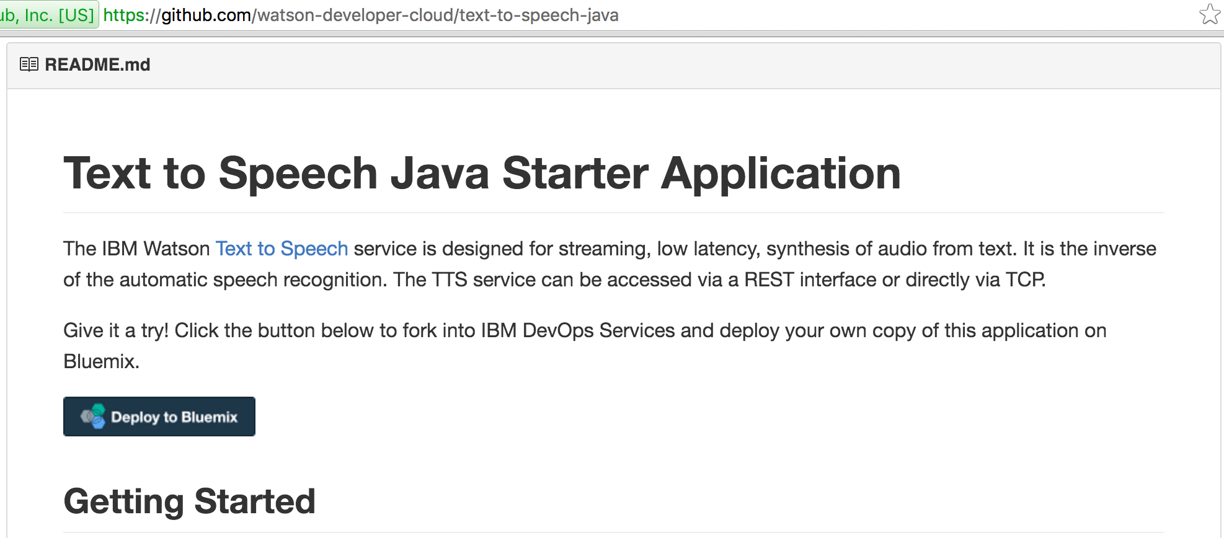
Hands on IBM Bluemix & DevOps

Slide 5
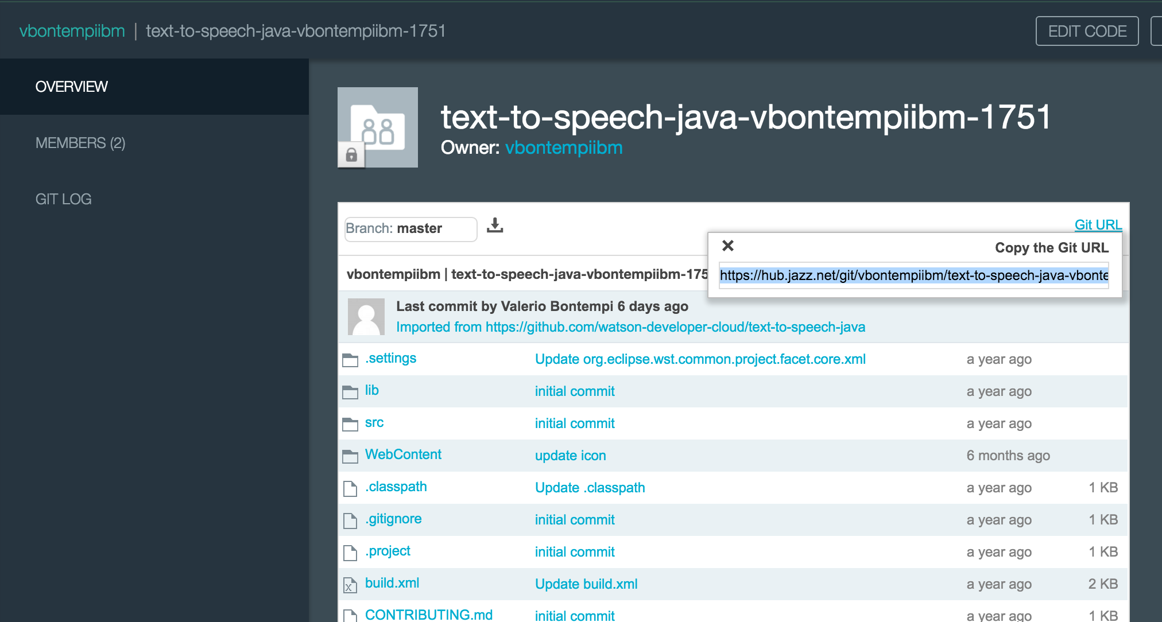
Hands on IBM Bluemix & DevOps

Slide 6
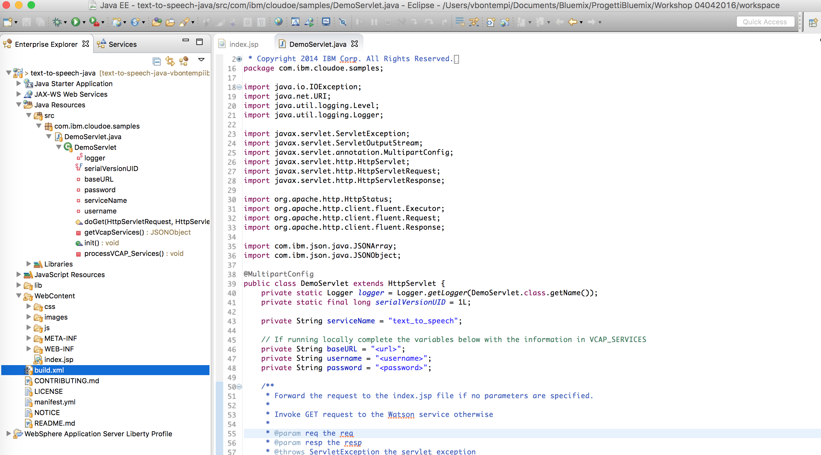
Hands on IBM Bluemix & DevOps

