Slide 1


INDRA FUTURE MINDS COMPETITION
Project presentation.

Slide 2
WHAT IS FUTURE MINDS?
THE COMPETITION
Indra Future Minds Competition is an inter-university competition for attracting talent.
Global reach: Europe, Latinamerica and Asia.
The contest is based on multiculturalism and new methods for working based on technology.
The contest is based on resolving enigmas proposed by Indra, based on real Indra projects.
Award: Indra´s hiring commitment of the two teams that reach the final, in one of the subsidiaries involved in the contest, chosen by the students.
Languages of the competition:
    The Contest communication will be done in Spanish and English.
    Students can communicate with each other in the language they choose.
    Projects can be submitted in Spanish, English or Portuguese.
The 2013 edition will be the third edition of the competition.

Slide 3
AWARDS
THE COMPETITION
Award for the video with the most votes
The group (6 participants) with the video that receives the most votes will receive a 16 GB iPod Touch for each member.
Award for the teams that pass the virtual phase
All the participants who reach the in-person phase (12) will receive an Apple iPad.
Travel, lodging and meal expenses during the final phase will be paid by Indra.
Award for the runner-up team
The members of the runner-up team will be offered a job at the Indra facility they select from the offices participating in the contest once the students have completed their degrees. Indra will cover any visa-related expenses.
Award for the winning team
The award for the members of the winning team will consist of an Indra job offer in the country selected by each student, from the offices participating in the contest, once the students have completed their degrees. Indra will cover the initial transfer expenses (shipping, insurance, visas and a €600 monthly stipend during the first twelve months) as well as two plane tickets at the six-month and twelve-month milestones of their hire date).

Slide 4
WHO CAN PARTICIPATE?
THE COMPETITION
Final year university students enrolled in the academic year 2012/2013.
Teams of 3 participants + 1 reserve. One of them will be the team captain.
Equipos de 3 participantes + 1 de reserva. Uno de ellos será el capitán del equipo.
1 team per university.
Student Profile
Telecommunication/Computer/Industrial Engineering Students.
Students in their final year of study.
Good academic records (their studies must be in line with the years established in their academic plan or one additional year).
Initiative.
Ability to work in a team.
Ability to communicate in English (spoken and written).
Good social and communication skills.
Strong professional development potential: With the desire to assume responsibility in his or her professional career
Other interests aside from their education (internships, scholarships, volunteer work, individual classes, etc.).

Slide 5
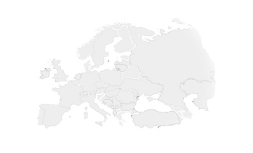
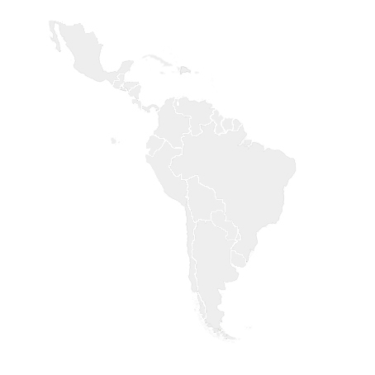
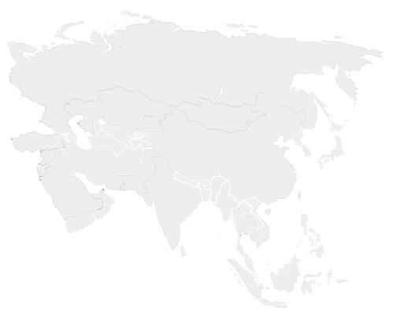

THE COMPETITION
COUNTRIES INVOLVED
Countries involved
LATIN AMERICA
  Peru
  Panama
  Brazil
  Mexico
  Colombia
  Chile
ASIA
  Philippines
EUROPE
  Spain
  Portugal
  Czech Republic
  Italy
  Turkey
  Norway
OCEANIA
  Australia
Calendar
PHASE 0
CV submitting/ Students selection
December 15th / January 15th 2013
VIRTUAL PHASE
March 11th/ March 29th 2013
IN PERSON PHASE
4 teams. 2 challenges
Brazil.
April 25th and 26th 2013

Slide 6
0 PHASE. PARTICIPANS SELECTION
DECEMBER 15TH/ JANUARY 15TH
THE COMPETITION
The university selects the students that meet the profile to defined participate.
Universities provide each participating office with the CVs of the students
from their country. The CVs are ranked in order to determine the participants and the substitutes.
Indra selects from each university the four students that most interest us. The university will notify those students and Indra will then contact them.

Slide 7
VIRTUAL PHASE. MARCH 11TH TO MARCH 29TH
THE COMPETITION
Indra defines the groups that will participate in the virtual phase: 1 Country university team 1 + 1 Country university team 2
Each group selects the enigma they would like to resolve.
A collaborative platform is developed. Using this platform, the teams can communicate and work on resolving the enigma. The platform will allow them to:
  Communicate with each other.
  Publish documentation.
  Contact the team responsible for the project.
Students must submit:
  A PowerPoint presentation with a maximum of 20 slides.
  A 2-3 minute video with the content that is defined.
  Additional documentation.
Once reviewed, the videos will be published in the external Indra website for general voting, and the voting results will be published in social networks. The group with the video that receives the most votes will receive a 16 GB iPod Touch for each team group member.
The votes received by the videos will not influence the jury's decision; instead, they will receive independent prizes.
Jury: The team responsible for the enigmas + Human Resources.
The criteria with which the proposals will be assessed will be based on Indra values.
Final result: Two groups (4 teams) will pass to the in-person phase.

Slide 8
IN PERSON PHASE. APRIL 25TH AND 26TH 2013
THE COMPETITION
It will take place in Brazil.
All the participants who reach the in-person phase (12) will receive an iPad or equivalent.
In this stage, each university will participate independently, not in groups as in the virtual phase.
The documentation for the enigmas to be resolved will be sent to the finalist teams in order to facilitate their presentations in the in-person phase.
This phase will include activities regarding knowledge about the company. Leisure activities may be added to the schedule.
The in-person phase is divided into two parts: The semi-finals, in which the four teams compete. Two teams will pass to the final, in which the runner-up and the winner will be decided.
Jury: Indra Manager responsible for the project in which the enigma is based + Human Resources + Customer representative of the project in which is based the enigma.
Final result: One winner team and one finalist team:
Winner team award: Indra´s hiring commitment, in the country chosen by students among the subsidiaries involved in the competition, once the student has completed their studies.
Indra will assume the innitial travel expenses (transportation, insurance, visa, and a 600€ monthly help for the first 12 months) and two plane tickets, at 6 months and 12 months of its incorporation.
Finalist team: Students will be able to apply to a position in Indra, in the subsidiary they choose among those involved in the competition, once the students has completed his studies.

Slide 9
PREVIOUS EDITIONS
THE COMPETITION
2011 Edition
Participant Countries: Spain, Mexico, Colombia, Brazil, Chile and Argentina
Awarded:
First place team: Universidad Politécnica de Cataluña (Spain).
Second place team: Instituto Tecnológico de Estudios Superiores de Monterrey y Campus Edo. De México.
Impacts on press: 41
2012 Edition
Participant Countries: Spain, Mexico, Colombia, Brazil, Argentina, Peru, Philippines, Czech Republic.
Awarded:
First place team : University of Philippines.
Second place team : Escuela Superior de Ingenieros de Telecomunicaciones Universidad Politécnica de Madrid (Spain).
Impacts on press: 98

Slide 10
MOST VALUED ASPECTS OF THE CONTEST BY STUDENTS
THE COMPETITION
The multicultural experience.
Knowing different projects that are carried out in an organization on the characteristics of Indra.
Knowing a complete project, not just the tasks that they will assume at the moment of becoming part of a company.
Increasing knowledge about the company.
In addition, the contest allows them to develop the necessary skills for a succesful incorporation into the professional world.
Teamwork.
Creativity.
Rigour.
Intercultural skills.
Skills related to virtual work.
Ability to acquire an overview of the projects..

Slide 11


Nombre Apellido Apellido
Departamento / Área de negocio
alias@indra.es
Avda. de Bruselas 35
28108 Alcobendas,
Madrid España
T +34 91 480 50 00
F +34 91 480 50 80
www.indra.es

