Slide 1
Hash-based constructions:
chains/trees
(with a few important applications)

Slide 2
Outline
TESLA for source authentication
  Not really hash-based → key idea = time-based
  But hash used in clever way
Merkle Trees
  Highly scalable data structure, amenable to (very!) large scale «big» data
  Compelling modern real world application: Certificate transparency
Blockchains
  Perhaps the most impactful innovation of the last decade
  Base of bitcoins
  But lots of promise well beyond virtual currencies

Slide 3
Source Authentication: TESLA

Slide 4
Issue: source authentication in multicast/broadcast
NODE A
Secret K
MESSAGE, HMAC(K,MESSAGE)
NODE B
Secret K
Unicast: one sender only → one possible message source.
Multicast? More than one possible source!
NODE A
Secret K
MESSAGE, HMAC(K,MESSAGE)
NODE B
Secret K
NODE C
Secret K
Spoofing possible!!

Slide 5
The problem and the “solution”
The problem:
  Symmetric authentication does NOT provide source authenticity in group communication
The solution:
  Digital signature, obviously…
  … but consider:
    High overhead
    Computational/time requirements for signing and (especially) verifying!
      Little more than 150 RSA-2048 decryptions/sec over fully dedicated Intel core 2 1.83 GHz with Vista 32 bit…
      Compare with symmetric auth, 3-5 ORDERS OF MAGNITUDE FASTER!

Slide 6
A possible alternative
Amortize signature cost over MULTIPLE packets
  Transmit P1…Pn
  At the end transmit signed H(P1…Pn)
  One signature every n packets
Killing problem:
  What about lost packets???
  What about fake injected packets
    one is enough to vanish all effort → DoS
  What about attacker flooding packets towards a receiver?
    bogus packets, supposedly containing a signature: computationally expensive verification → DoS!

Slide 7
TESLA
TESLA = Timed Efficient Stream Loss-Tolerant Authentication
  A. Perrig, R. Canetti, J. D. Tygar, D. Song (2000)
  RFC 4082
Symmetric authentication mechanism
used… “asymmetrically”!!!
  Asymmetry = time!
Proposed in the frame of MSEC (Multicast IPsec)

Slide 8
Basic Assumption
time synchronization (loose)
  No need for precise sync
  But devices must be able to at least distinguish «epochs»
  Packets invalid if received after a max number of epochs (e.g. after 2 epochs)
Invalid: packet out of time
X
PKT
t=1
PKT
t=1
PKT
t=2
PKT
t=1
Time epoch 1
Time epoch 2
Time epoch 3
Time epoch 4

Slide 9
Basic idea!
Use symmetric HMAC
But use key known only by the sender!
And delay disclosure of key!
Sender:
generates key K known only to himself
Transmits MSG, HMAC(K,MSG)
Receiver:
Buffers MSG and waits
Sender:
now broadcasts key K
Receiver:
Verifies that MSG was authentic!
…………
Time epoch N
Time epoch N+x

Slide 10
Problem
What if message containing key is lost?
  All received packets in an epoch cannot be authenticated anymore!

Slide 11
Solution: Key chains
Problem
What if message containing key is lost?
  All received packets in an epoch cannot be authenticated anymore!
K0 = H(K1)
Kn-1 = H(Kn)
Kn = random
Usual idea: use keys in reverse other from their (chain) generation
Result: receiver needs only to read one key to authenticate all past msg – hence tolerating losses

Slide 12
Technical details
Omitted, but in essence:
  Key chain: differs from key used in auth
  Synchronization protocols
  Hash chain: efficient computation and maintenance, o(log^2 N)
    Opposed to linear (elementary approach)
Refer to RFC or papers

Slide 13
Merkle Trees

Slide 14
Frequent practical problem: how to sign a chunked msg
VERY LONG MESSAGE
SIGNATURE
Peer-to-peer delivery
  Message divided into independent chunks
  Frequently received out of order, and from distinct peers
Signature verification: needs to wait until COMPLETE message reconstruction
  But what about fake injected chunks?
Per-chunk signatures: too expensive and too much overhead
Can we find a better solution?
…
CHUNK 1
CHUNK 2
CHUNK 3
CHUNK 4
CHUNK N

Slide 15
Merkle’s idea: Hash tree
Digitally signed
ROOT = H( H{H[H(A),H(B)],H[H(C),H(D)]} , H{H[H(E),H(F)],H[H(G),H(H)]} )
H{H[H(A),H(B)],H[H(C),H(D)]}
H{H[H(E),H(F)],H[H(G),H(H)]}
H[H(A),H(B)]
H[H(C),H(D)]
H[H(E),H(F)]
H[H(G),H(H)]
H(A)
H(B)
H(C)
H(D)
H(E)
H(F)
H(G)
H(H)
A
B
C
D
E
F
G
H

Slide 16
Single chunk verification: use “siblings”
ROOT = H[C3, S3]
C3 = H{S2,C2}
S3 =H{H[H(E),H(F)],H[H(G),H(H)]}
S2 = H[H(A),H(B)]
C2=H[C1,S1]
H[H(E),H(F)]
H[H(G),H(H)]
H(A)
H(B)
C1=H(C)
S1 = H(D)
H(E)
H(F)
H(G)
H(H)
A
B
C
D
E
F
G
H
Log(N) siblings needed

Slide 17
Traditional Applications
Chunk validation (see example)
One-time signatures
Node authentication
Memory & storage authentication
Signature spreading
…. Many more …

Slide 18
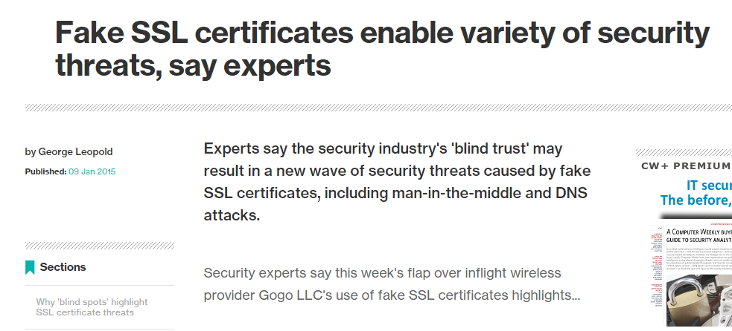
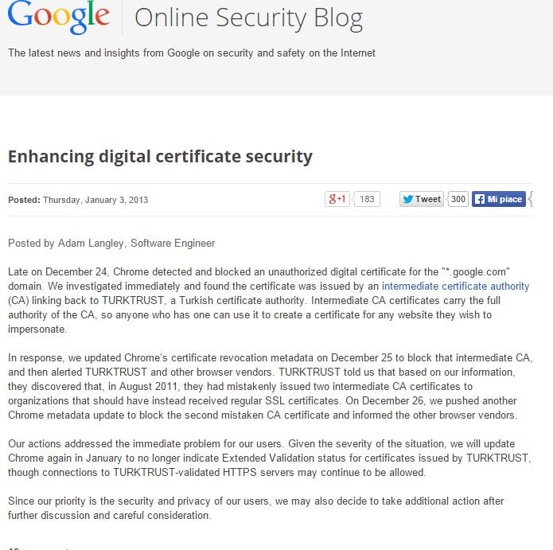
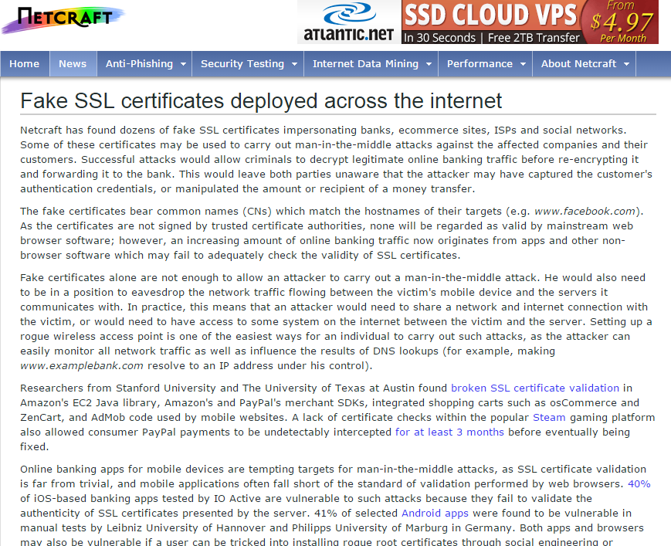
A real world (recent) application: certificate transparency

Slide 19
A serious problem
Fake VALID certificates
  Variuous small/moderate CA «releasing» valid certificates for major sites
    Asked by governments? Mistakenly… lost?
    Many cases:
    google fake certificates issued by
      Turkey’s Turktrust, December 2012
      ANSSI in France on December 2013
      etc
Conmpromised CAs
  Holland: DGnotar
  Malaysia: DigiCert sdn. Bhd.
  etc
With powerful threats (governments), and many players which can «make mistakes»
the security of the PKI model is getting weaker and weaker

Slide 20
Why certificate transparency?
Make it almost impossible for a CA to issue a SSL certificate for a domain without the certificate being visible to the owner of that domain.
Idea: put all certificates in a gigantic public list, that everyone can access and consult
Further idea: make sure that we all see the “same” list!!
  New threat: “split world”: the public list you see is different (and crafted!) from what the rest of the world sees

Slide 21
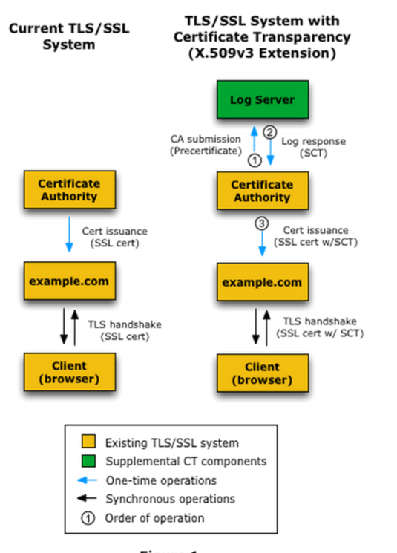
Certificate Transparency in a nutshell
When issuing certificate: add it to the log server
  Returns a Signed Certificate Timestamp (SCT)
During TLS handshake:
  Check certificate validity (as usual)
  Follow up with an additional Extended Validation (EV) by verifying that the certificate is in the public list

Slide 22
Certificate Transparency
Google’s initiative
  started 2013
First stated in experimental RFC 6962
  July 2013
Endorsed and supported by IETF WG «trans»
  Goal: standardize CT
  RFC 6962bis released in December 2014
Currently integrated in major browsers
  Chrome 1+, IE7+, Firefox 3+, Safari 3.2+, Opera 9.5+
  Although not yet consistently used by all web sites
  Plan to improve support for Extended Validation by 2015
Details @
http://www.certificate-transparency.org/

Slide 23
CT: how it works?
Uses Merkle trees!
  Very scalable, log(n) verification complexity
A special type (sometimes called chron tree)
  «append only» Merkle tree
  Timestamped entries
    Cannot retroactively insert a certificate
Following figures: source http://www.certificate-transparency.org/log-proofs-work

Slide 24
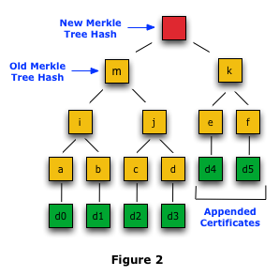
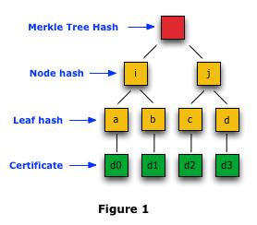
CT: how it works?
Every X hours, tree updated (currently X=24h)

Slide 25
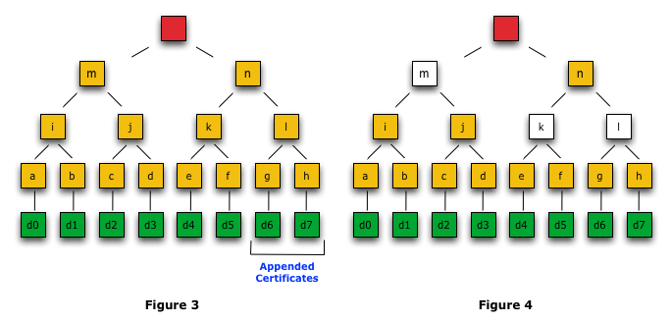
Merkle Consistency proof
Verify that two versions of a log are consistent (i.e., the later includes everything of the earlier).
Consistency proof → no certificates have been modified or back-dated and inserted into the log.
Proof = need only root of the subtrees – includes past “root”

Slide 26
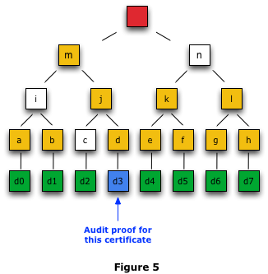
Merkle Audit Proof
Usual: via certificate + siblings
Siblings obtained from log
  Issue: online operation, visible to all…
  Remember who are the threats today…
Alternative: use «gossiping» protocols
  Work in progress @ 2015!
  No time for (very nice) details…

Slide 27

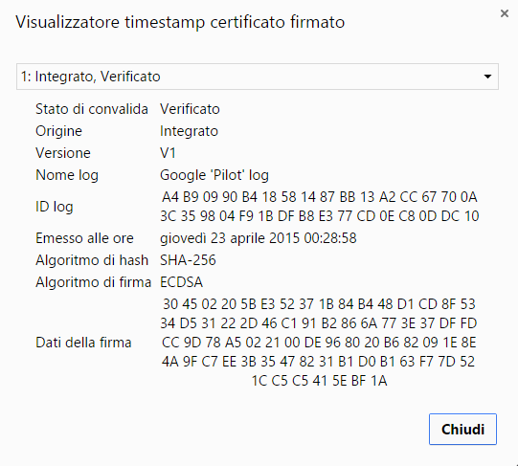
EV in the real world

Slide 28
Hash Pointer Data Structures
(a.k.a. blockchains)

Slide 29
Problem
(quite related to previous Merkle Trees, but a few extra caveats)
Append-only data
  Data organized in “blocks”
  To be securely logged and stored
    Adversary should not be able to modify stored data
  New data blocks arrive in time
Data
Block
1
Data
Block
2
Data
Block
3
…

Slide 30
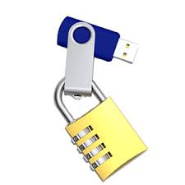
Hash pointer: verify integrity of single block
Hash of the block
may have two roles:
Integrity
Location (!!)
  Use hash as «address»
  of «where» the block
  is located
H[ ]
Data
Block
1
e.g. H[] = 12543678AF32
location = server #12
Remember DHTs? ☺
We will NOT care today
about location
Secure (small) storage:
You fully control it
Insecure (large) storage:
Adversary can tamper

Slide 31
«chaining» data blocks
H[ ]
0000000
H[ ]
H[ ]
Data
Block
1
Data
Block
2
Data
Block
3
How to retrieve the data [remember: hash pointer may also tell about location!]:
- start from securely stored H[ ], locate block 3, check its integrity
- from block 3 go to block 2
- go up to final leaf

Slide 32
Resilient against data tamper
H[ ]
0000000
H[ ]
H[ ]
Data
Block
1
Data
Block
2
Data
Block
3
Attacker tampers block 1
But cannot produce an hash collision
  Hence must go downstream and “correct” also hash pointer of block 2
But hash pointers ARE included in hash!
  Hence must go up to root hash to succeed
  But if this is secured, game over!

Slide 33
May use multiple hash pointers per block
Reduces depth of log
  Extra «routing» info needed ☺
  For choosing the proper branch
Works for any direct acyclic graph data structure
  Hence Merkle trees as special case of binary trees
H[ ]
Data
Block
N-1 (2)
H[ ]
H[ ]
H[ ]
H[ ]
Data
Block
N
H[ ]
Data
Block
N-1 (2)

Slide 34
Data block may be further organized as Merkle tree
H[ ]
0000000
H[ ]
H[ ]
Merkle Tree Root
1
Merkle Tree Root 2
Merkle Tree root 3
H[ ] H[ ]
Very close to cron trees
previously used in CT
Similar organization in
bitcoin blocks
H[ ] H[ ]
H[ ] H[ ]
Data A
Data B
Data C
Data D

Slide 35
Blockchains and crypto currencies
(e.g. bitcoin)
PART 1: intro
Partial credit to Princeton University slides of the course on Bitcoin and Cryptocurrency Technologies
(a few slides adapted or imported from theirs)

Slide 36
A brief history of money
around 1750 BC: Babylonia
  First appearance of Money and banking
  Initially as deposits of grain
  Then other goods → including precious metals
Early money: Gold
  widely accepted
  divisible
  easy to measure
  easy to carry
  non-perishable (although it wears out)
  impossible to forge

Slide 37
A brief history of money
Paper money
  About 950 AC, China
  Initially as a claim on gold
    But much more portable
  No natural (intrinsic) value,
    acceptance backed by guarantees from a central authority
  during tumultuous economic periods, drove gold out of circulation
Money today: not anymore linked to gold, but issued by states!
  How much money around → decision of states / central banks
  Economic issue, not my job!

Slide 38
Digitalization of money
debit/credit cards, paypal, etc
  Money becomes a number in your account
  Money exchange is now an electronic transaction from one account to another
Issue: privacy!
  With ordinary cash:
    You withdraw money → bank does NOT know what you will do with it
    You buy something → merchant does NOT know who you are
  But with credit card…
    Bank knows how, where, and when, exactly, you spent your money
    And merchant knows who you are

Slide 39
E-cash, 1983, David Chaum
Digital money which guarantees anonymous transactions!
VERY Brilliant idea
  Blind signature
  key tool in many other constructions
But no practical success
  Startup company Digicash in 1989, bankrupt in 1998
    No real privacy awareness by end users
    Focus on user-to merchant, not on user-to-user
  Credit cards ultimately won the «online payment» battle…
    But after 20 years, perhaps crypto currencies are changing the game…

Slide 40

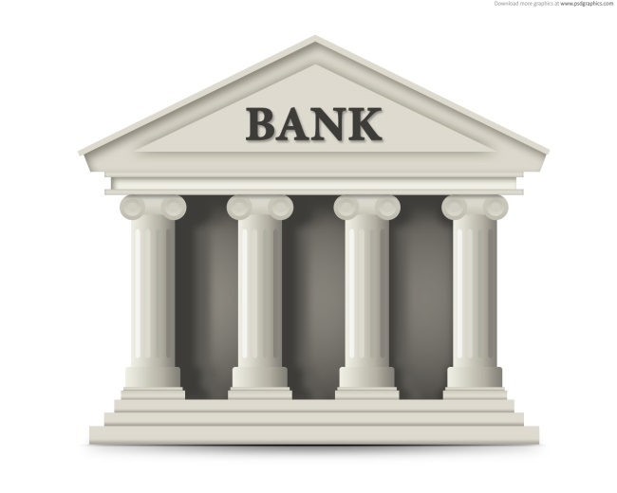

Basic e-cash idea
Must have unique S/N → bits can be copied!
Issue 10$ bill
1
SN#A541
Issuer
Bank sig
Must have bank signature → bits can be copied!
2
Pay
reclaim
Detect double
spending
3
SN#A541
Issuer
SN#A541
Issuer
Traceable:
Bank knows
who I paid
Bank sig
Bank sig

Slide 41
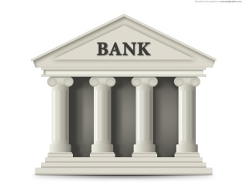

Chaum’s (core) idea many more details and necessary extensions skipped
The bill MUST have a S/N
  For double spending detection
The bank MUST not (initially) know it
  To avoid traceability
But the bank MUST digitally sign the bill
Blind signature: permits to sign something you don’t see!!!
M
Bank sig
M =
Rand S/N
Divide by B → M^{d}
M’ = M x B^{e}
B = random blinding factor
e = Bank Public Key
[M’]^{d} = M^{d} x B^{ed} = M^{d} x B

Slide 42
Bitcoin challenge:
Get rid of ANY central authority / intermediary
Central (trusted) authority/intermediaries usually used for:
  Registering and handling user identities (accounts)
  Registering transactions, transferring money, and checking double spending
  Issuing (generating) money!
    trusted central monetary authority which issues the money according to a monetary policy
      A state authority, the European Central Bank, etc

Slide 43

Identity: not a problem
Idea: use public keys as identities
  Fully decentralized approach becomes easy!
Use PK as identity
hash[PK] is called «address» in bitcoin
Generate a pair:
PK = Public key
SK = Private Key
Sign every transaction you perform with SK
Anyone which sees a transaction from you=PK can verify
That it’s really you, by simply checking the signature

Slide 44

Step by step…
ADDRESS = H[PK] = a1b2c3d41235ef
Account name
256 bits, 64 hex string
in bitcoin (SHA-256)
A1b2c3d41235ef → msg = «transfer 1 BTC to GB» | signature(msg)
GB → retrieves PK for (anonymous) user a1b2c3d41235ef
→ checks that H[PK] = a1b2c3d41235ef
collision resistance protects from impersonation:
not possible to claim different PK for a given address
→ verify(PK, message, signature) = TRUE
only a1b2c3d41235ef knows private key SK!
No need for any intermediate/central authority to issue/manage «accounts»
Decent level of privacy (as long as multiple identities are used for multiple transactions)

Slide 45
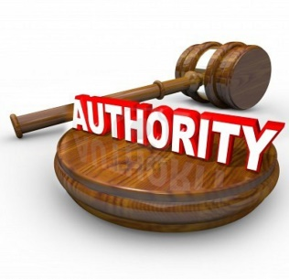
Logging transactions
Authority creates coin
Authority transfer coin to DEVIL
  i.e. authority «pays» DEVIL
  DEVIL identity: PK_{DEVIL}
  DEVIL now owns coin
DEVIL pays GB
  GB now own coin
Pk_{auth}
SK_{auth}
1 coin
SN1234 (unique)
Signature by PK_{auth}
Pay SN1234 to DEVIL
H[ ]
Signature by PK_{auth}
Pay SN1234 to GB
H[ ]
Signature by PK_{DEVIL}

Slide 46
Double spending:
THE biggest problem in e-money!
Who prevents DEVIL to pay GB and MR with same coin???
1 coin
SN1234 (unique)
Signature by PK_{auth}
Pay SN1234 to DEVIL
H[ ]
Signature by PK_{auth}
Pay SN1234 to MR
Pay SN1234 to GB
H[ ]
H[ ]
Signature by PK_{DEVIL}
Signature by PK_{DEVIL}

Slide 47
Easy only if we involve (again) authority!
1 coin
SN1234 (unique)
GB
Signature by PK_{auth}
Pay SN1234 to MR
H[ ]
Pay SN1234 to DEVIL
Signature by PK_{GB}
H[ ]
Signature by PK_{auth}
1) Check transaction request:
Your identity is GB and
signature is valid (you are
hence really GB)
Pay SN1234 to GB
H[ ]
Signature by PK_{DEVIL}
H[ ]
Keeps hash pointer to last transaction, and check new transaction

Slide 48
Easy only if we involve (again) authority!
1 coin
SN1234 (unique)
GB
Signature by PK_{auth}
Pay SN1234 to MR
H[ ]
Pay SN1234 to DEVIL
Signature by PK_{GB}
H[ ]
Signature by PK_{auth}
2) Check log:
GB was indeed the
last to own such coin
Pay SN1234 to GB
H[ ]
Signature by PK_{DEVIL}
H[ ]
Keeps hash pointer to last transaction, and check new transaction

Slide 49
Easy only if we involve (again) authority!
1 coin
SN1234 (unique)
GB
MR
Signature by PK_{auth}
Pay SN1234 to DEVIL
H[ ]
Signature by PK_{auth}
3) Insert block in chain
If all OK, record transaction
in the block chain
Only now MR owns the coin!
Pay SN1234 to GB
H[ ]
Signature by PK_{DEVIL}
Pay SN1234 to MR
H[ ]
H[ ]
Signature by PK_{GB}

Slide 50
Ledger (multiple transactions into blocks)
One «big» ledger, append-only
Roganized into blocks
  Inside blocks multiple transactions (as list or – preferable - merkle trees)
In crypto currency, permits to «split» coin units
time
H[ ]
H[ ]
H[ ]
F account balance
securely logged in
blockchain:
Trans 112(2) → +2.4
Trans 114(4) → -1.9
…
Block ID 112
Block ID 113
Block ID 114
Issue(A, 25)
…
…
B→F (2.4)
M→N (2.4)
…
D→H (0.1)
…
…
…
…
F→H (1.9)
Problem: F balance
can be reconstructed
only by crawling
back to the very
beginning!
F pays 1.9 to H
H[ ]
Signature by PK_{F}

Slide 51

(example, restricted to transactions involving only F)
Issue(F, 25)
F→G: 12
H→F: 7
M→F: 16
F→X: 21
F→Y: 4
Is this valid???
F→Z: 13

Slide 52
The actual bitcoin transaction-based ledger (simplified example: one transaction per block)
Block ID 112
Trans ID 11
Idea: transaction has inputs and outputs
  All inputs MUST be transformed into outputs
  Hence no need anymore to reconstruct full history, only previous transaction
Inputs: 0
Outputs: 25 → Flavia
Block ID 113
Trans ID 21
Inputs: [112][11](0)
Outputs: 11.8 → Bonny,13.1→Flavia, 0.1→fee
Signed: Flavia
Block ID 114
Trans ID 32
Inputs: [113][21](0)
Outputs: 11.6 → Bonny,0.2→Mark
Signed: Bonny
Block ID 115
Trans ID 01
Inputs: [113][21](1)
Outputs: 10 → Cyrus,3.1→Flavia
Signed: Flavia

Slide 53
Multiple inputs
MERGING & SPEND
CONSOLIDATE
Block ID 112
Trans ID 11
Block ID 112
Trans ID 11
Inputs: 0
Outputs: 25 → Flavia
Inputs: 0
Outputs: 25 → Flavia
Block ID 113
Trans ID 21
Block ID 113
Trans ID 21
Inputs: …
Outputs: 12 → Flavia
Signed: Alberto
Inputs: …
Outputs: 12 → Flavia
Signed: Alberto
Block ID 114
Trans ID 32
Block ID 114
Trans ID 32
Inputs: [112][11](0), [113][21](0)
Outputs: 29→Bonny,8→Flavia
Signed: Flavia
Inputs: [112][11](0), [113][21](0)
Outputs: 37→Flavia
Signed: Flavia

Slide 54
Blockchains and crypto currencies
(e.g. bitcoin)
PART 2:
from trusted centralized authority
to untrusted decentralization!
(Distributed ledger technology)

Slide 55


Horrible Scenario
Fully distributed, heterogeneous
  Nodes may crash
  Nodes may leave
No global time guarantee
No Network guarantee
  Unbounded latency
  No delivery guarantee
  No full mesh connectivity
No node identities
  Pseudonymity is a goal
Malicious nodes (bizantine adversary model)
  May control multiple nodes
  May attempt double spend
  May do… anything bad!
Transactions may generate from any node
And are broadcast to remaining (no guarantee though)
A→C
A→B
Node 4
A→B
Node 3
Node 1
A→C
Node 5
Node 2
Node 5
A→B
Node 6
Who maintains the ledger?
Who decides if transactions are valid?
Who collects transactions and adds new blocks?

Slide 56
Distributed Consensus
Each node MUST SEE the SAME ledger
  Ledger periodically updated with new blocks & relevant transactions
    One block circa every 10 minutes
HARD (distributed consensus) problem, two requirements
  All (correct) nodes should (ultimately) have the same view
  (ultimately) registered transactions should have been proposed by correct nodes
Poor support from theory
  Very discouraging impossibility results
  Fischer-Lynch-Paterson [1985]: consensus impossible even with a single (!) faulty node

Slide 57
Bitcoin «pragmatic» approach
Not perfect, not supported by strong theory, but… it works!
  Incentive is the key!!
  Well behaving nodes get rewarded
    With bitcoins → more later
Relaxed requirements
  We accept slow convergence of consensus, about o(1h)
  We do NOT need strict time ordering
    As long as transactions are from different users
  We detect double spending
    But we may eventually happen to fix it in favor of cheater than of legitimate user ☹
      Though very rare, thanks to proper «heuristics»

Slide 58
Bitcoin approach: implicit consensus!
No protocol at all!
  No leaders, masters, elections; no messages among nodes
Random-based approach
  Select random node at regular time (approx 10m) – more later on this!
  Selected node adds block to the chain – including transactions seen by the node so far and checked as valid (inputs=outputs, valid signatures, etc)
    delayed transactions not a problem, can be included in next block
Implicit acceptance – next selected node:
  extends chain from there → implicitly accepts block
  Extends chain from previous block → implicitly rejects block
Selected node @
t=i+3: accepts
Block i
Block i+1
Block i+2
New block
time
New block
Selected node @
t=i+4: rejects

Slide 59
Key rule (for honest nodes)
Always extend longest subchain if branch (of valid blocks) detected
Block chain is the chain which survives
  Stale short sub-chains will not be part of chain
  And will be ultimately removed
Works if honest random node selected with more than 50% probability
  Heuristic: after 6 blocks = 1h you have sufficiently high probability that «your» branch will be included

Slide 60
Possible attacks
Steal your money
  Not possible, attacker does not know your private key
Keep you out of the blockchain
  Attacker registers blocks with all transaction except yours
  But first honest block will include you back ☺
    Will simply assume your transaction has been delayed – operation robust to large delays or outages
F→B
F→B
F→B
F→B

Slide 61
Double spending attack
Record first spending F→B
  And let it be included in block
Meanwhile double spend: F→C, and assume attacker has NOW a chance to append its own block
Option 1: append at the end
  does not work
  Next block from honest would check and see invalid block at the end
  and would branch it out
  Following blocks would be appended only to valid path
F→B
F→C
??? Not valid!

Slide 62
Double spending attack
Record first spending F→B
  And let it be included in block
Meanwhile double spend: F→C, and assume attacker has NOW a chance to append its own block
Option 2 (better chance): make a branch!
  If next blocks added to F→C’s one, transaction F→B will NOT exist…
    B will lose money! That’s why some Bitcoin merchants add delay…
  Fact: other nodes cannot know which transaction is «legitimate»
    What cares is that only one is registered!
F→B
Both valid! Pick one..
F→C
Take-home message: only probabilistic guarantee that transaction is in consensus branch
→ but probability of being out vanishes exponentially as branch grows (against <50% attacker)

Slide 63
OK so far. But how nodes are selected… and what «choose node at random» means??
PART 3:
Mining, incentives, & proof-of-work!
i.e: why bitcoin works, and where bitcoins come out from!

Slide 64
Make distributed consensus work
IF nodes honest, THEN consensus would work very well
  Honest nodes: problematic assumption in such trustless scenario
THE major bitcoin enabler: give nodes incentives for creating VALID blocks
  Valid block → gets into blockchain → give reward
  Invalid block → stale branch → no reward
  Make such that reward is «greater» than reason to cheat
The nature of bitcoins as currency now comes into (strong!) play
  Give money (bitcoin) to those which produce valid blocks!

Slide 65
Two incentives
For each block created, give create a fixed quantity of BTC
  Key idea for booting the blockchain
  And the way BTCs are issued without any central authority
  Block creation called «mining» – analogy with traditional miners of gold
For each transaction included in a block, give a «fee»
  Paid by those who perform transactions
  No «creation» of BTC here

Slide 66
Coin creation
Creator of block is rewarded with a special coin-creation transaction placed in the block
  Fixed amount of BTCs “created” by each block
    Block creator can choose recipient address to give such BTCs to (typically yourself)
  Initially 50 BTC, halves every approx 4 years
    Precisely: every 210.000 blocks @ 10m each = 1458 +1/3 days
    25 BTC from late 2012, 12.5 BTC from mid 2016, next halving June 21, 2020
Block creator gets to “collect” the reward only if the block ends up on long-term consensus branch!
  That’s why you’d be interested in behaving honestly!

Slide 67
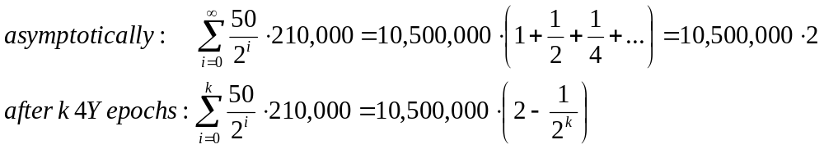
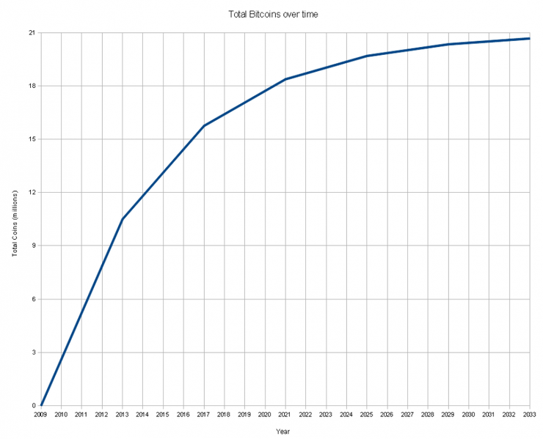
Hown many bitcoins?
Geometric series: converges to finite value!
  Asymptotically, 21M bitcoins, of which 99.9% by 2048
Total supply: 21 M
Today, June 15 2017, # BTC = 16,391,338, % = 78.05%
Total bitcoins in circulation
First inflection point:
reward halved from 50BTC to 25BTC
Year
Plot taken from Princeton University course

Slide 68
Second incentive: fee
How to guarantee honest behavior when block creation reward will become negligible?
  Longer term idea : add a fee to every transaction recorded in a block
  Fee goes to block creator
  Originally optional, but is becoming mandatory
    As of today, June 15, 2017, average fee is 367 satoshi/byte (1 satoshi = 10⁻⁸ BTC = smallest unit)
    Currently, about 2-3 extra BTC per block (varies)
Block ID 113
Trans ID 21
Inputs: [112][11](0)
Outputs: 11.8 → Bonny,13.1→Flavia, 0.1→fee
Signed: Flavia

Slide 69
How to pick a «random» node?
Select random node HARDLY an option. For two reasons
  Who performs the actual selection?
    No coordination!
  Trivial to cheat via sybil attack → game over
(much!) better idea: approximate a random selection in proportion to «some resource» that (we hope) nobody will be able to monopolize
Bitcoin idea: proof-of-work
  proportion to computing power
    Seems reasonable that a single miner won’t be able to recruit more than 50% of the total computing power
  Mining a block = solving an hash puzzle

Slide 70
Hash puzzles
nonce
To create block, find nonce s.t.
H(nonce ‖ prev_hash ‖ tx ‖ … ‖ tx) is very small
prev_h
Tx
Tx
Output space of hash
000000
Target
space
Example (from block @ June 15, 2017) 000000000000000000a1bbd2265918a5bd3ef80694ecd9b36fd3dfdea13dc750
If hash function is secure:
only way to succeed is to try enough nonces until you get lucky
Slide taken from Princeton University course
Notes:
If Alice has 100x more computing power than Bob it doesn’t mean she always wins the race. It means she has about a 99% chance of wining. In the long run Bob will create 1% of the blocks

Slide 71
Key properties of an hash puzzle
Must be hard but not too hard
Hardness must be parametrizable
Must be easy (fast) to verify solution

Slide 72
Hardness
Focus on SHA-256
  Digest M = 2²⁵⁶
Puzzle parameter: difficulty D
  (varies in time)
  June 15, 2017: set at 678,760,110,082.99 x 2³² i.e. almost 2⁴⁰ x 2³²
Puzzle: find nonce s.t.
H(nonce, rest of block) < M/D
  P(solve in 1 attempt) = 1/D ≈ 2⁻⁷²
  P(solve within N attempts) = 1-(1-1/D)^{N} ≈ 1-e^{-N/D}
  E[number of attempts] = D
If miner can compute R hash/s
  P(solve by time t) ≈ 1-e^{-R t / D}
  Average time to mine a block: T= D/R
  Example: PC @ ≈ 35MH/s → T ≈ 2⁷²/2²⁵ ≈ 2⁴⁷s ≈ 2⁴⁷s ≈ 4.5 Myears!
Total computing power currently in bitcoin network
  R = hash rate = 4,723,788.73 TH/s
  T ≈ 678,760,110,082.99 x 2³² / 4,723,788.73e12 ≈ 617s ≈ 10m
Parameter D adjusted every 2 weeks to keep 10m average!!

Slide 73
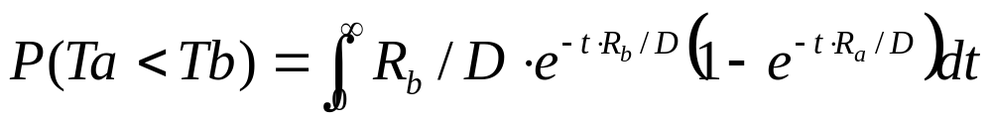
Key property
Alice hash rate = R_{a}
Bob hash rate = R_{b}
Prob(Alice mines next coin) =
R_{a}/(R_{a}+R_{b})
Probability proportional to computational power! What we originally wanted!!

Slide 74
Blockchains and crypto currencies
(e.g. bitcoin)
PART 4: further insights
(just a list of IMHO interesting topics as of now)

Slide 75
Bitcoin economy
Makes sense if reward > cost
Cost:
    Hardware for mining
    Electricity cost
Estimate: by 2020 bitcoin network could consume 14000 MW
  Equal to the whole Denmark!
Emerging malware miners
  Use electricity paid by someone else ☺

Slide 76
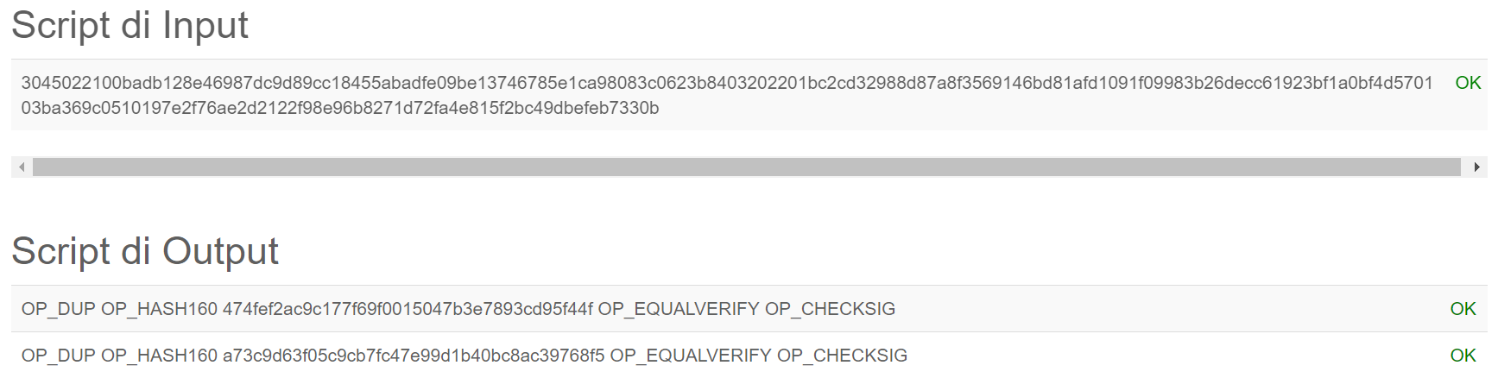
Blockchain scripts
Blochckain transactions: scripts!
  Stack-based language
    Forth-like
    NOT Turing complete → fast, no loops etc
  Example: basic script for signature check
    i.e. pay BTCs to someone via a signed transaction
More advanced scripts → smart contracts
  Hectic interest for applications beyond currency

Slide 77

Multi signatures
(disputed case)
(normal case)
Pay x to Bob
SIGNED(ALICE, BOB)
Pay x to Alice
SIGNED(ALICE, JUDY)
Judy
To: Alice
From: Bob
Pay x to 2-of-3 of Alice, Bob, Judy (MULTISIG)
SIGNED(ALICE)
Alice
PROBLEM: Alice wants to buy online from Bob. Alice doesn’t want to pay until after Bob ships.
Bob doesn’t want to ship until after Alice pays.
Bob
Slide taken from Princeton University course
Notes:
Gavel from OpenClipArt.com

Slide 78
Efficient micro-payments
What if Bob never signs??
Input: x; Pay 42 to Bob, 58 to Alice
SIGNED(ALICE) SIGNED(BOB)
all of these could be double-spends!
Input: x; Pay 42 to Bob, 58 to Alice
SIGNED(ALICE)___________
...
Alice demands a timed refund transaction before starting
Input: x; Pay 04 to Bob, 96 to Alice
SIGNED(ALICE)___________
Input: x; Pay 100 to Alice, LOCK until time t
SIGNED(ALICE) SIGNED(BOB)
I’m done!
I’ll publish!
Input: x; Pay 03 to Bob, 97 to Alice
SIGNED(ALICE)___________
Input: x; Pay 02 to Bob, 98 to Alice
SIGNED(ALICE)___________
Input: x; Pay 01 to Bob, 99 to Alice
SIGNED(ALICE)___________
PROBLEM: Alice wants to pay Bob for each minute of phone service. She doesn’t want to incur a transaction fee every minute.
Bob
Alice
Input: y; Pay 100 to Bob/Alice (MULTISIG)
SIGNED(ALICE)
Slide taken from Princeton University course
Notes:
What if Bob never paid?

Slide 79
Alternative crypto currencies
Called altcoins
  E.g. Litecoin, Ethereum, etc
Different design
  Learned from the past
Will they fly?
  Not a real world usage, unlike bitcoin

Slide 80
Privacy
Very interesting area!
  Reasonable privacy
  But pseudonym-based → «some» deanonimization possible!
    Good work around, including Shamir in 2012
    https://eprint.iacr.org/2012/584.pdf

Slide 81
Many game theoretic issues
Fees!
  If I don’t offer any fee, no miner might include my transaction
    Other transactions bring more money to miner
  What is the «right» fee I should offer?
  Race condition? Equilibrium?
Designing incentive mechanisms
Chain dynamics
  Multi-party, selfish
  Miners tend to aggregate
  ???

Slide 82
Killer blockchain applications
Most people think to IoT, energy, micro-transactions, financial, etc
  We’ll see
Private vs public blockchains
  Huge interest in private blockchains
    Nothing trailblazing, just an application/extension of Merkle Trees and hash pointer data structures, we already knew long time ago
    Perhaps overclaimed (blockchain is trendy, hence…)
    But blockchain awareness can boost…
What about Certificate Transparency-type, but with public blockchain
My own «killer app»: VAT!
  A serious (unsolved) problem in an highly untrusted scenario (frauds, money, etc)

Slide 83
Who is Satoshi Nakamoto?
An open story
  We’ll see a movie sooner or later
Just one remark: he/she must be VERY rich now!
  He/she mined most of the initial BTCs
    50 BTC/block, 1 block/10m → 2.6MBTC/year
  First bitcoin transaction: pizza for 10.000 BTC
  Now 10.000 BTC > 20Meuro!

