Slide 1
Lecture 8:
Elliptic Curve Crypto
A (minimal) introduction

Slide 2
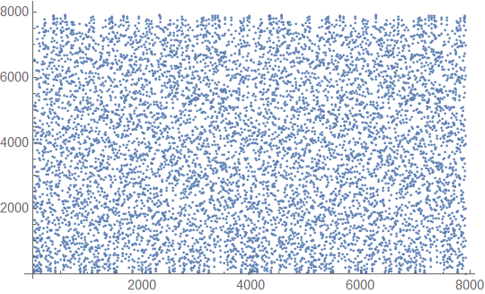
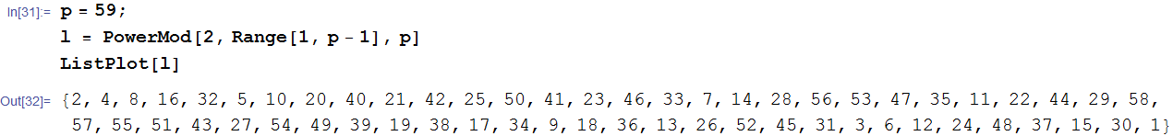
Why bothering with ECC?
Computational security = Hard problems
  Easy in one way
  Hard in the other way
Example: discrete logarithm
  Z*(p), p>2 prime, group order q
    x → g^{x} mod p easy
    g^{x} → x mod p hard
  Not restricted to Z*(p), can be any cyclic group Gp
2^x mod 7919

Slide 3
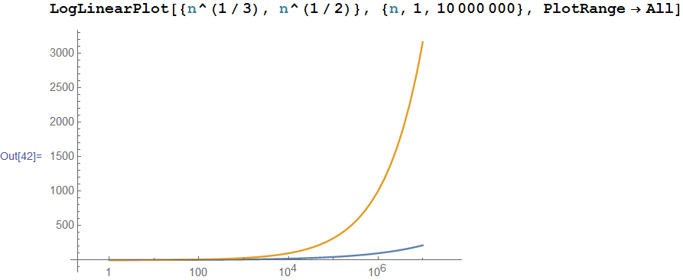
Why bothering with ECC?
Same problem (e.g. Dlog, factoring), different “hardness” in different groups!
  Dlog in Z*(p): exp(O(n^{1/3}))
  Dlog in EC: exp(O(n^{1/2}))
Symm key equiv modulus size
80 bits 1024 bits
128 bits 3072 bits
256 bits 15360 bits
Elliptic Curve
160 bits
256 bits
512 bits
EC scales well (so far) with increased security parameter!!
Obvious long term deployment choice (now clear why so many new EC ciphers in TLS)!

Slide 4
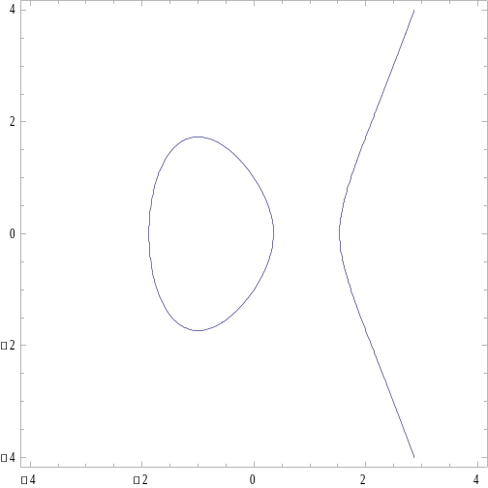
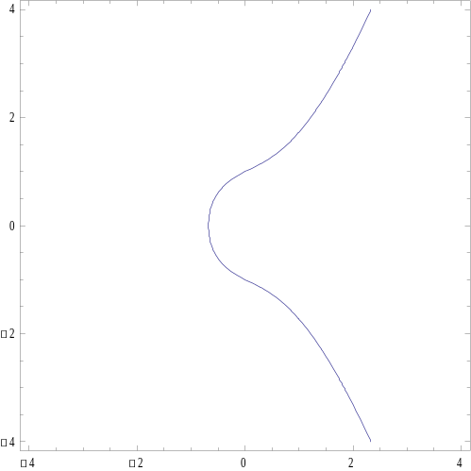
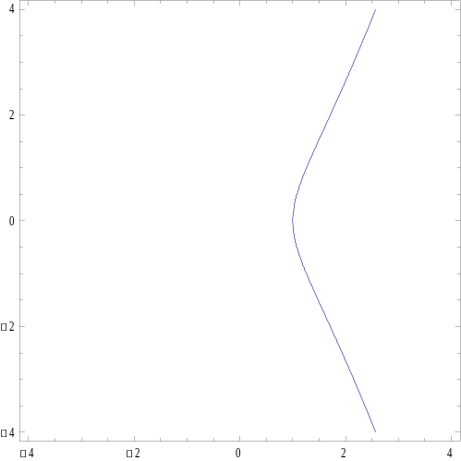
Elliptic curves
They are NOT ellipses!
  They are special cubic curves
  Named from elliptic integrals
General (Weierstrass) expression
y² = x³-3x+1
y² = x³+x+1
y² = x³-1,

Slide 5
We need an operation
We want an operation
  call it “+” or “⬇”
    historically called +, though someone today may prefer mult. notation
So that P+Q=R → R
BELONGS to the curve
AND the operation gives algebraic group structure

Slide 6
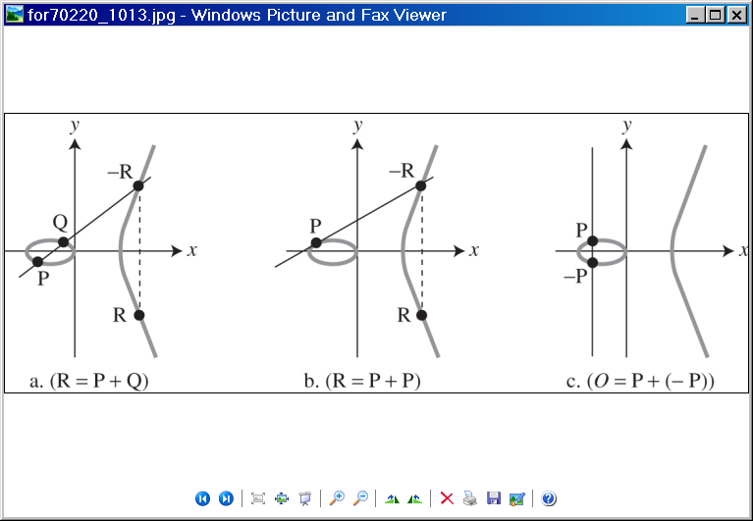
Elliptic points addition P+Q
(geometric)

Slide 7

Elliptic points addition P+P
(geometric)

Slide 8

Elliptic points addition P-P
(geometric)
“complete” the curve by adding point O=-O to infinity
P+O=P
  O is (additive) zero for the group of EC points
  Now clear why the “inversion” ☺

Slide 9
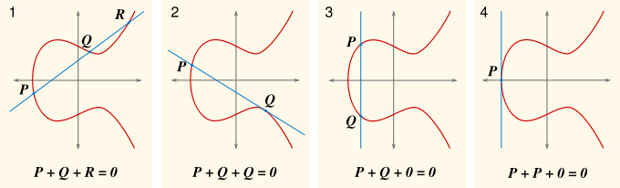
General rule
If three points of an elliptic curve lay on a same line, their sum is 0

Slide 10
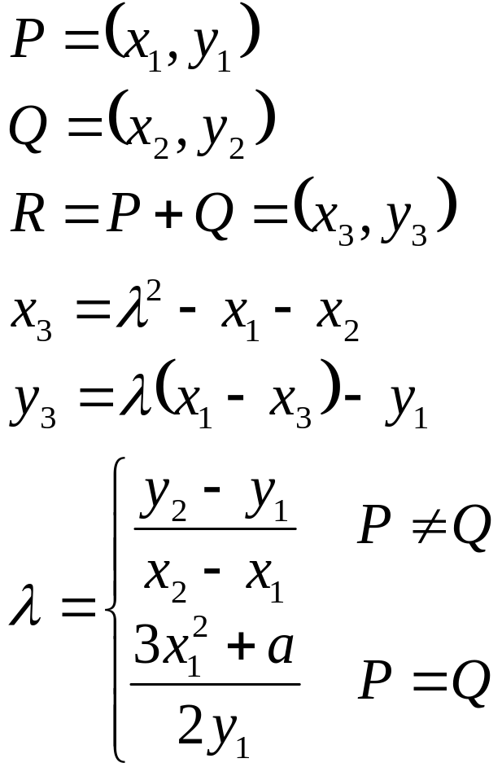
Algebraic expressions
Can be derived from geometric interpretation

Slide 11
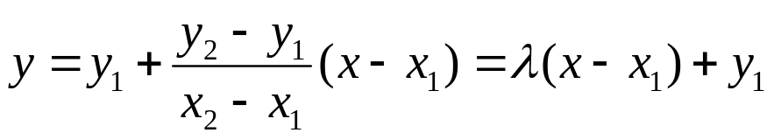
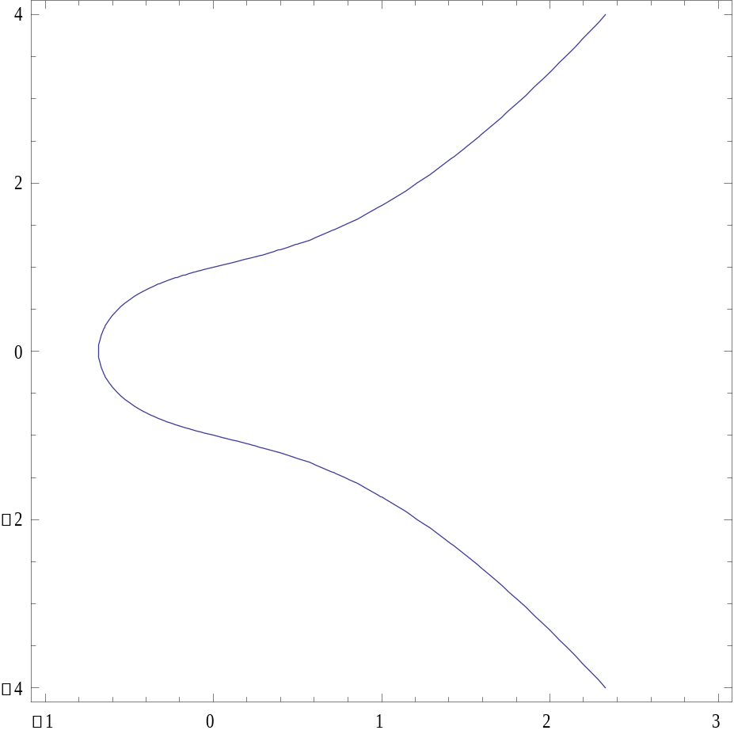
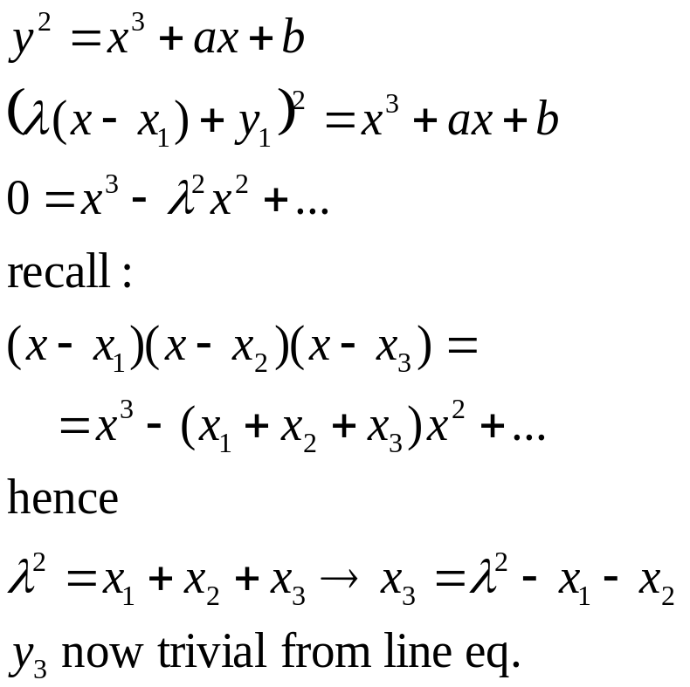
P≠Q sketch
-R
Q
P
R

Slide 12

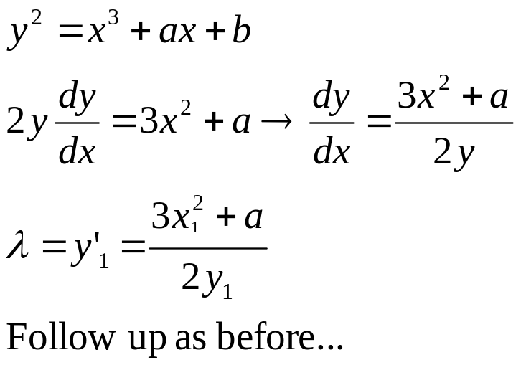
P=Q sketch
-R
P
R

Slide 13
Elliptic curve group
(over Zp)

Slide 14
EC over modular integers
Geometric interpretation
  Over real numbers
Our applications
  Over modular integers
Define “curve” as
  E_{p}(x,y) such that
    x,y integers in Zp
    y² mod p = x³ + a x + b mod p
Finite field → finite # of points

Slide 15
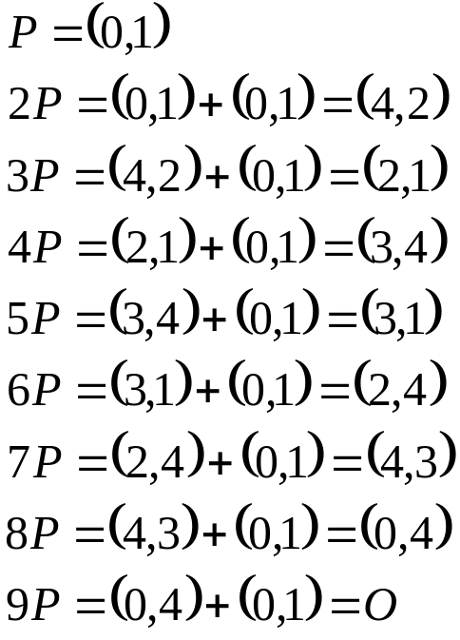
Example: x³+x+1 mod 5
All points:
  pairs (i,j), i in [0,4], j in [0,4] s.t. j²=i³+i+1 mod 5
  And O
  Result: 9 points
  Let P=(0,1)
    k P=P+P+…+P
    generates all the points

Slide 16
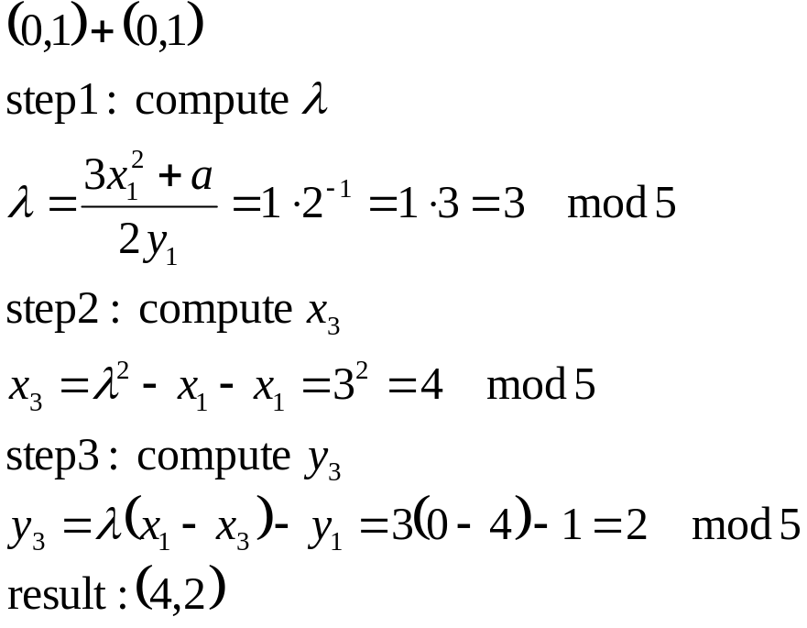
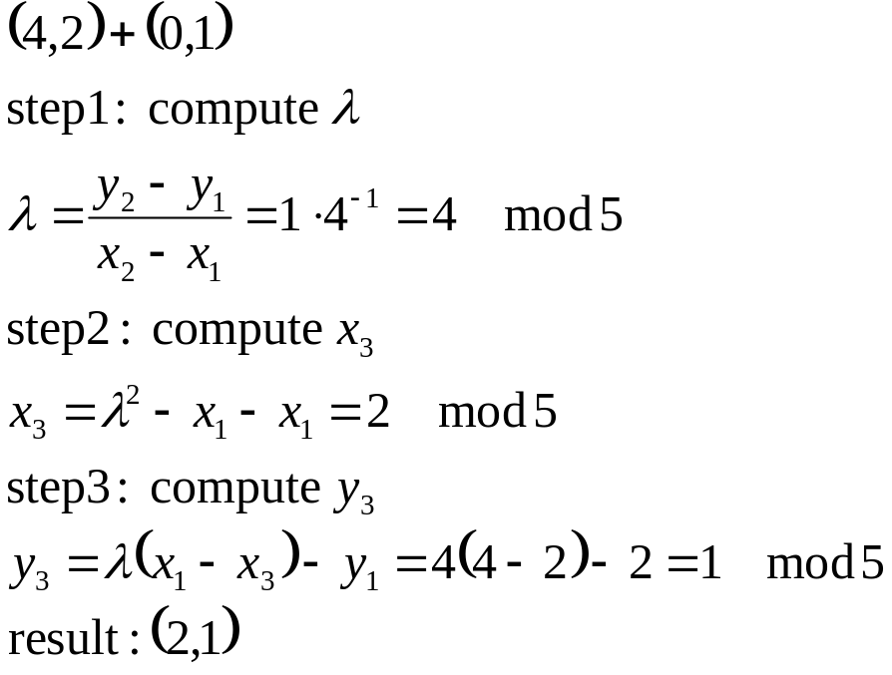
example computation
Many online calculators available e.g. http://www.csulb.edu/~wmurray/java/WillEllipticApplet.html

Slide 17
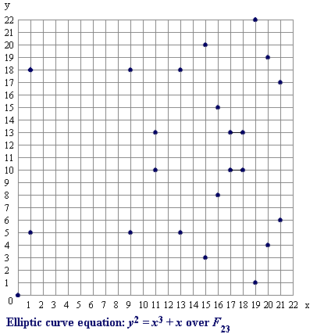
Which points in “larger” group?
No geometric “look&feel” anymore…
no problem!

Slide 18
EC group
(E(Z_{p}),+) is a group
  Addition closed on set E
  Addition is commutative
  O is identity wrt addition
  Every point P in E has inverse –P wrt addition
  Associative property holds
    Harder to prove in generality, but holds
Abelian group

Slide 19
EC Group properties for crypto
Easy/hard operation: [k]P
  Given P and k, easy to compute [k]P
  Given P and [k]P, hard to compute k
    P = elliptic curve point on group
    k = integer mod group order
  “Equivalent” to Dlog problem on Zp
    If we had used multiplicative notation: k → P^{k}
CRUCIAL: DEPEND ON THE CHOSEN CURVE!!!
  Use curves recommended by standards!!!!
  Curves not only in Zp, but also in GF(2^{m}) – Binary curves: convenient!
Different EC curves satisfy different assumptions!
  We’ll see (and exploit!) later on: e.g. CDH hard but DDH easy

Slide 20
Multiplication (exponentiation)
Group order 160 bits → q=2¹⁶⁰
Major cost: multiplication
  analogous to exp
  Uses very large factors k (160 bits)
Efficiency: approx 1.5 Log₂ q
  i.e. linear with the number of bits
    Basic algorithm: double and sum
      (analogous to square & multiply)

Slide 21
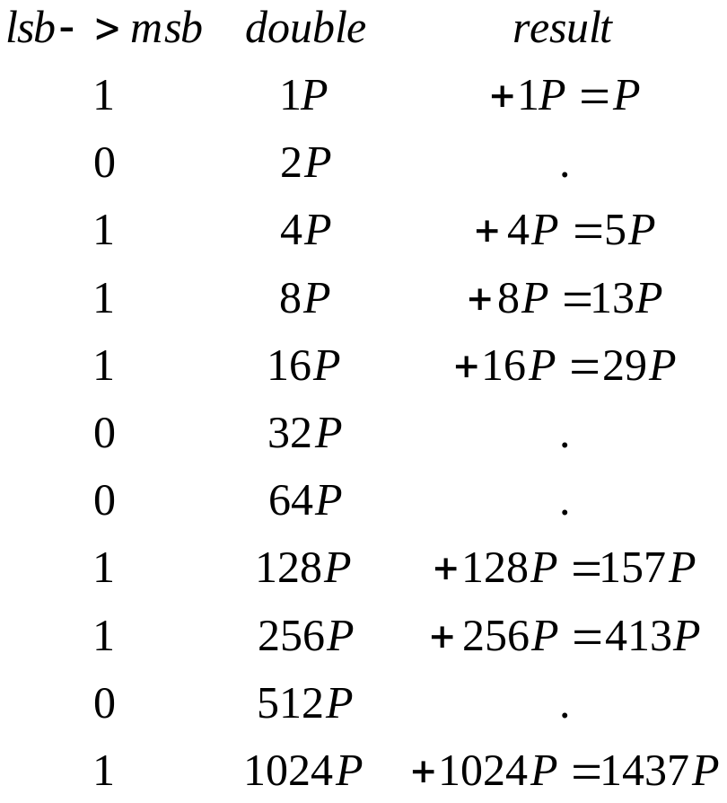
Example
Goal: compute [1437]P
Express in bits
  1437₁₀=10110011101₂
Initialize first line
  Differs if 0 or 1
Start from 2° lsb to msb
  For every bit
    Double;
    If 1: add to result
Complexity:
  O(nbit) x2
  O(nbit/2) additions
No algorithm such as this for the opposite problem!! That’s why it is hard!

Slide 22
Elliptic curve crypto
(examples)

Slide 23
EC crypto
Invented in 1985
  Neal Koblitz
  Victor Miller
  (independently)
Security: based on hardness of:
  Given P and [k]P, hard to compute k
  Elliptic Curve Discrete Log Problem – ECDLP
Much shorter keys than RSA/DLP
  And better scaling!
Symm key equiv modulus size
80 bits 1024 bits
128 bits 3072 bits
256 bits 15360 bits
Elliptic Curve
160 bits
256 bits
512 bits

Slide 24
ECDH/ECDSA
Topmost used, since included in US National Security Agency – suite B ciphers
Suite B: NIST-approved, promoted in 2005, adopted in TLS, IPsec, S/MIME, etc
Algorithms:
  Encryption: AES 128/256
  Key Exchange: ECDH
    256 and 384 bit prime curves
  Digital Signature: Elliptic Curve Digital Signature Algorithm (ECDSA)
    256 and 384-bit prime moduli
  Hashing: SHA-256 and SHA-384

Slide 25
ECDH
Exactly as DH
  Just use as group an EC group!
(prime p of Zp, curve param a and b, group order q)
C
x, [x]G
secret = [xy]G
G, [x]G
S
y, [y]G
secret = [yx]G
[y]G

Slide 26
ECDSA
Elliptic Curve Digital Signature Algorithm
  EC version of DSA
    Invented by Vanstone
    Proposed by NIST in august 1991
  adopted by NSA Suite B
Variant of ElGamal
  Dlog based
Famous also for other reasons ☺
  Broken in Playstation 3, 2010
    Not because ECDSA is vulnerable…
    Because of incorrect usage, see later

Slide 27
Let’s first remember DSA
(simplified)
Multiplicative group
  Z*(p), p>2 prime
  Large prime q in group order
    Usually p = 2q+1 (safe prime)
Generator
  g s.t. g^{x} mod p spans all group elements
Private/Public keys
  d, y = g^{d} mod p

Slide 28
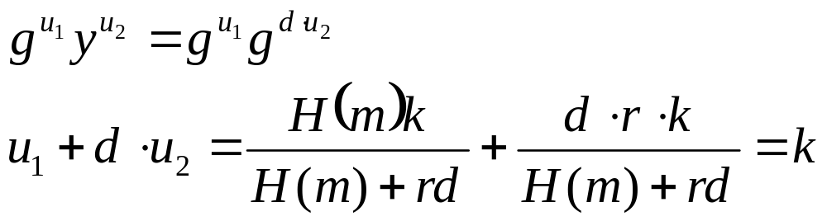
Let’s first remember DSA
(simplified)
Signature for message m
  Random k in (1,q)
  Compute r = (g^{k} mod p) mod q
  Compute s = k⁻¹ (H(m)+ d r) mod q
  Signature: (r,s)
Verification
  Compute u₁ = s⁻¹ H(m) mod q
  Compute u₂ = s⁻¹ r mod q
  Verify ((g^{u1} y^{u2}) mod p) mod q = r

Slide 29
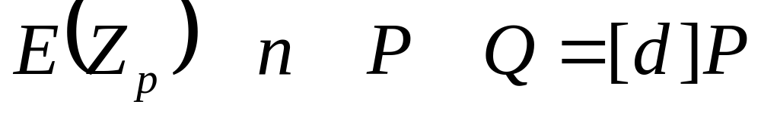
ECDSA: setup
Group
Order
(prime, large)
Selected Elliptic
curve over Z_{p}
Group
Generator
Public param
& pubkey:
Public Key
Private key:
  d = random integer in [1,n-1]
  Q = dP

Slide 30
ECDSA: signature generation
k in [1,n-1]: random integer
  ESSENTIAL: MUST BE
    unique per each signature
    unpredictable
Compute kP=(x₁,y₁) EC point
  x₁ is integer, then
Compute r = x₁ mod n
Compute k⁻¹ mod n
Hash function H(.) e.g. SHA
Signature:
(r,s)
s=k⁻¹(H(m) + d r)

Slide 31
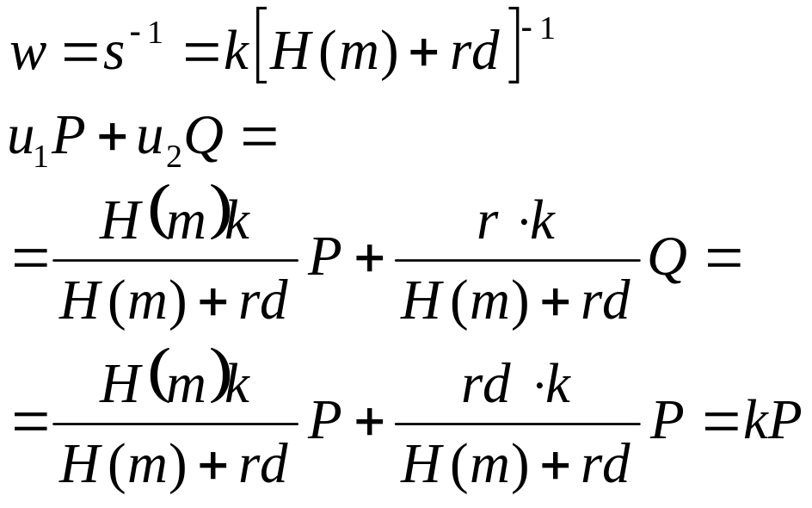
ECDSA: verification
From message m
  compute H(m)
From s
  compute w=s⁻¹ mod n
Compute integers:
  u₁ = H[m] w mod n
  u₂ = r w
Compute elliptic point
  u₁ P + u₂ Q = (x₀,y₀)
Compute
  v = x₀ mod n
Verification:
v=r
Note: k never disclosed!

Slide 32
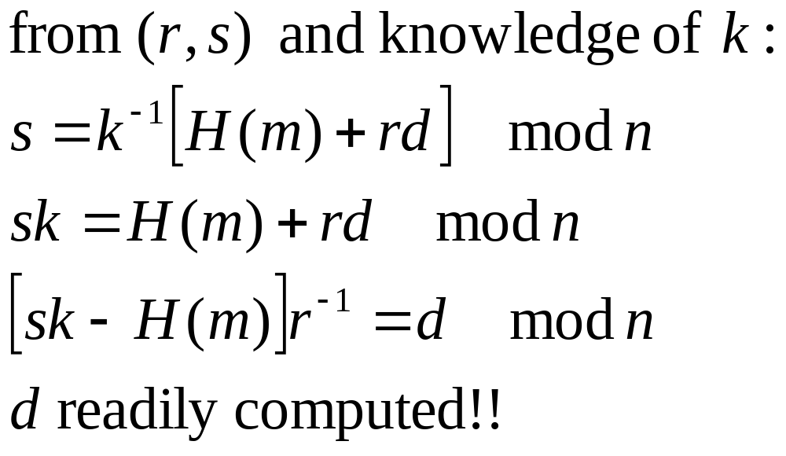
What if k predicted??
Private key would be disclosed!

Slide 33
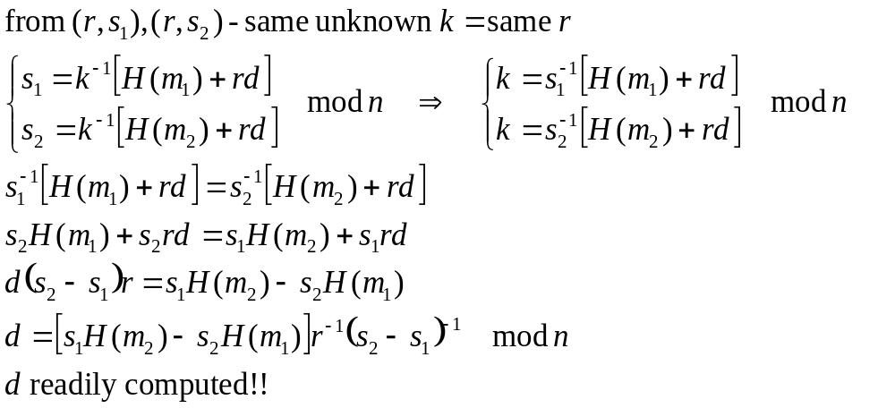
What if k repeated??
Private key would be disclosed!
This is what happened with Sony’s Playstation 3

