Slide 1
Lecture:
Transport Layer Security
(secure Socket Layer)
Recommended reading:
Stephen Thomas, “SSS and TLS essentials”, Wiley, 2000
Very old and in some parts obsolete, but very well written

Slide 2
Lecture’s twofold goal
Dissection of well known and widely employed security protocol
  Rasonable in-depth analysis of TLS details
    Devil is in details ☺
    Although many more details had to be skipped (this is not a full course on TLS…)
Understand how a long-to-live security protocol should be designed
  Show good design choices vs bad ones
    TLS shows several examples for both!

Slide 3
Introduction to TLS

Slide 4
History of SSL/TLS
SSL v1
by Netscape
never released
1994
SSL v2
Integrated in
netscape 1.1
Badly broken!
SSL v3
Redesigned
from scratch
by Netscape
…
1995
1996
TLS v1.0
First IETF design
(versus Netscape)
1996-1999
RFC 2246, jan 1999
TLS v 1.1
RFC 4346
Apr 2006
DTLS
RFC 4347
Apr 2006
UDP support
TLS v 1.2
RFC 5246
Aug 2008
Get rid of now weak
MD5/SHA-1hash
(negotiated PRF,
default SHA-256)
…
TLS = SSL with minor modification
TLS1.0=SSLv3.1
  However NOT backward compatible with SSL 3.0
Public Domain implementation
available @ www.openssl.org

Slide 5
SSL/TLS: layered view
HTTP
SMTP
……
HTTP
SMTP
……
https
smtps
TCP/UDP/ANY
SSL/TLS
IPsec
TCP (if UDP, then DTLS)
IP
IP
Network layer security
Transport layer security
SSL/TLS: on top of TCP, but below application layer
  (can be considered as top sublayer for L4 or bottom for L7)
  SSL/TLS: NOT a security enhancement of TCP!
Not necessarily limited to Internet transport (L4)!
  Devised for point-to-point relationships in general
  E.g. EAP-TLS (RFC 2716)
    TLS mechanisms employed for authentication and integrity protection over L2 EAP

Slide 6
Application support
Typical approach: reserve special port number for SSL/TLS mediated application
  Example:
    port 80 = HTTP over TCP
    Port 443 = HTTP over SSL/TLS (HTTPS)
  SSL/TLS common application port numbers
    smtps 465 (MS) or 587 (others)
    spop3 995
    imaps 991
    telnets 992
    …
  Pros
    works well; de facto standard
    Straightforward application support!!
  Cons:
    2 reserved port numbers for same service
    deprecated by IETF (but still here…)
Alternative approach: slightly adapt application’s internals
  App reuses same port number
  Example: HTTPv1.1: upgrade: TLS/1.0
  new http command (see RFC 2817)
HTTP
SMTP
HTTP
http
80
smtp
25
TLS
TLS
http
80
https
443
smtps
587
TCP/IP

Slide 7
Compare with IPsec (e.g. AH)…
0
3
7
15
31
Version
Header
length
Type of Service
(DSCP+ECN)
Total Length
16 bit identification
flags
3 bit
13 bit fragment offset
Time to Live
TTL
Protocol=51
Header checksum
32 bit source IP address
32 bit destination IP address
Variable,
if any
Options (if any)
Next Header
AH Payload length
(SN+ICV in 32 bit w)
RESERVED (all 0)
Security Parameters Index (SPI)
Sequence Number field
AH
len
Integrity Check Value (ICV)
variable
DATA (if tunnel mode: IP header + DATA) (if transport mode: TCP, UDP, other)

Slide 8
TLS Goals
Establish a session (TLS Handshake phase)
  Agree on algorithms
  Share secrets
  Perform authentication
Transfer application data
  Communication privacy
    Symmetric encryption
  Data integrity
    Keyed Message Authentication Code (HMAC)
TLS approach: two-in-one
  Other Internet security protocols may clearly distinguish the protocol for establishing a session (e.g., IPsec IKE) from the protocol that delivers data and enforces security services (e.g., IPsec ESP/AH)

Slide 9
TLS protocol stack
HTTP, etc
Trivial protocols!
Error Handling
start cipher
Establishes
session &
Initializes
communicaton
Handshake
Protocol
Alert
Protocol
Change
Cipher
Spec
Application
on TLS
Minor modification
of apps may be
necessary (e.g.
see RFC 2817/2818
for
HTTPS #443
HTTPv1.1 ext
TLS Record Protocol
Data transfer
Possibly
special app port#
TCP

Slide 10
TLS Record Protocol

Slide 11
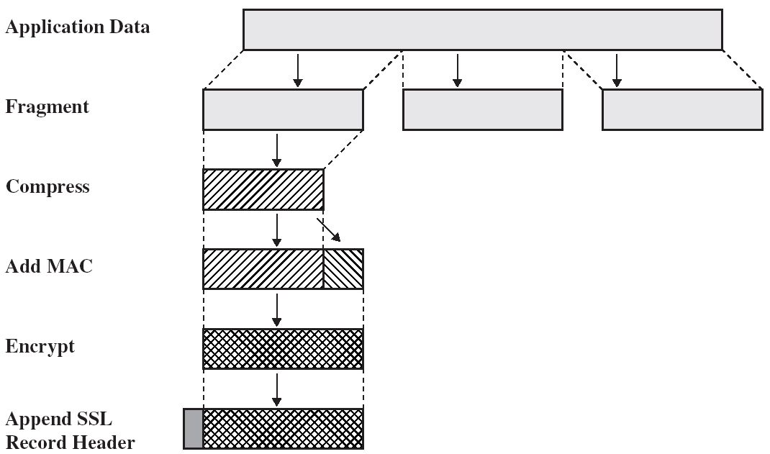
Record Protocol operation
Record Protocol:
takes messages to be transmitted from apps
fragments the data into manageable blocks
optionally compresses the data
applies a MAC
encrypts
and transmits the result.
Reverse operation at reception (decryption,
verification, decompression, reassembly,
delivery to apps)

Slide 12
Fragmentation
At application ←→TLS interface
  DON’T get confused with TCP segmentation!!
Input: block message of arbitrary size
  possibly multiple aggregated messages of SAME protocol
Fragment size: 2¹⁴=16384 bytes

Slide 13
Compression
Lossless compression
  Formerly used in SSLv2
Considered in TLSv1.0 but not specified
  «null» compression method in SSLv3 and TLSv1.0
2004, RFC 3749: introduces DEFLATE (RFC 2951)
  RFC 3943 – support for Lempel-Ziv-Stac
More recently: considered appealing
  Widespread diffusion of “verbose” languages – e.g. XML
  @ early 2012:
    45% of the browsers (including Chrome & Firefox)
    42% of the servers
Suddently died ☺ in september 2012
  CRIME attack, more later

Slide 14
Message Authentication Code
MAC computation
  Secret (symmetric) key derived from security parameters negotiated during handshake
  Hash function: negotiated during handshake
  Computation: uses HMAC construction
    keyed-hashing Message Authentication, RFC 2104
message
HMAC

Slide 15
Encryption
Fragment Encryption
  Applies to both (compressed) fragment and MAC
  No encryption possible
    If no encryption negotiated
    Or in early handshake phases
Symmetric encryption algorithm
  Block or stream cipher
    Algorithm (RC4, 3DES, AES, etc) negotiated during handshake, too
    If block cipher, padding necessary to achieve block size
    Secret key derived from security parameters negotiated during handshake
    Differs from key used in MAC
  Encryption algorithm CANNOT increase size of more than 1024 bytes

Slide 16
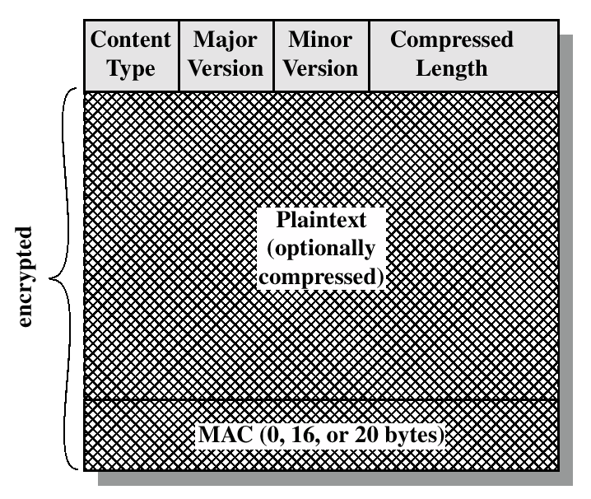
Record Protocol Data Unit
Application data OR Alert
OR Handshake OR
Change_cipher_spec
3.1 for TLS
5 bytes header
  Content type = 1
  Version = 1+1
  Length = 2
Content Type
  higher layer protocol
    20 = 0x14 = Change Cipher Spec
    21 = 0x15 = Alert
    22 = 0x16 = Handshake
    23 = 0x17 = Application Data
or ++

Slide 17


What about replay?
I really want to pay 2000$
Pay 1000 $
HMAC
Pay 1000 $
HMAC
I want to pay 1000$
Pay 1000 $
HMAC
Pay 1000 $
HMAC
But I’ll make you pay twice!

Slide 18
Sequence numbers
Client
C_seqnum
Server
S_seqnum
kept at both connection extremes
  Distinct per-direction
  Initialized to 0; up to 2⁶⁴-1; do NOT wrap
Not transmitted
  Remember: reliable transport, hence no “holes”
  Aftermath: NO WAY TO AVOID TCP!
    Explicit 2+6=8 bytes sequence number added in DTLS

Slide 19
MAC generation details
Not TX!!!
Sequence number
TLS record header
Content type | version | length
DATA
HMAC-XXX (MD5/SHA-1 up to TLS1.0; SHA-256 default TLS1.2)
Negotiation may decide not to use MAC
  In practice, always present
Sequence number:
  Not transmitted but included in the MAC
    to detect missing/extra data
    and to prevent replay/reordering attacks

Slide 20
More insights on encryption + authentication

Slide 21
Encryption vs Integrity
Integrity: prevent attacker from tampering with message
Integrity may be the only requirement
  Why “also” encrypt (extra effort) if not needed by scenario?!
Encryption may NOT guarantee integrity!
  In many encryption schemes, attacker may modify encrypted message

Slide 22
Encrytion does not nearly guarantee integrity!
One time pad (one time random key K): perfect secrecy... But:
  Encryption: ENC(M) → C = M⊕K
  But:
    C⊕M’ = (M⊕K)⊕M’ = (M⊕M’)⊕K=ENC(M⊕M’)
    “pay 1000 $” ⊕ “…(1 ⊕ 9)…” → “pay 9000 $”
Not the only case
  RC4: same as above
  Homomorphic encryption: modifiable by design!
    including RSA
In general, don’t trust encryption mechanisms for integrity
  unless they are explicitly designed ALSO for it (authenticated encryption, e.g. AES-CCM, AES-GCM, etc)

Slide 23
How to combine ENC + MAC?
TLS: MAC then ENCRYPT
DATA
MAC(DATA)
IPsec: ENCRYPT then MAC
DATA
MAC(ENC)
SSH: ENCRYPT and MAC
DATA
MAC(DATA)
Issue: which construction is best, in the assumption of
  GENERAL (semantically secure) Encryption scheme
  GENERAL (unforgeable) MAC scheme

Slide 24
Encrypt and MAC (SSH)
Most insecure!
  Unforgeable MAC construction does NOT guarantee anything about information leakage!
  MAC (not encrypted, and applied to plaintext) may reveal something about the message!

Slide 25
MAC then Encrypt (TLS)
Not recommended!
  Pathological counterexamples
    Krawczyk, Crypto 2001: explicit costruction
      Uses active attacker against tailored and “strange” (but shannon’ secure) ENC
  Practical attacks found
    on some specific (unusual) IPsec configurations (Degrabriele, Paterson, ACM CCS 2010)
      Yes, IPsec may be “re”configured to use MAC then encrypt! [e.g. use AH then ESP with encryption only]
  But also positive results
    MAC then encrypt provably secure with
      Stream ciphers
      CBC

Slide 26
Encrypt then MAC
Provably secure
  If semantically secure Encryption scheme
    Note: ENC not required to be secure against active attacks!
  And unforgeable MAC scheme
Conclusion:
  If given the choice,
  ALWAYS use ENC then MAC, i.e. Ipsec-style

Slide 27
Attacks to TLS (CBC) encryption

Slide 28
TLS encryption?
Not a single scheme!
  TLS supports a number of ciphers!
  Attacks apply to specific ciphers
Attack categories:
  Against “bad” ciphers
    Obvious
  Against “bad” usage of ciphers made by TLS
    less obvious!
  In either cases, practical exploitation of vulnerabilities may not be that obvious

Slide 29
Background: Block ciphers
Two “ingredients”:
  A “secure” Pseudo Random Permutation
    Reversible Transformation for a single block
      3DES (n=64 bit, k=168 bit)
      AES (n=128 bit, k=128 | 192 | 256 bit)
  A “secure” way to combine block transformations to encrypt a text of arbitrary length
      Cipher Block Chaining - CBC
      Counter mode – CTR
      …
Plaintext block
(n bits)
E = encrypt
D = decrypt
Ciphertext block
(n bits)
Key K

Slide 30



From PRP to cipher: what NOT to do
Electronic Code Book
Same PT block → same CT block!
    Leaks info on data patterns (NO semantic security)
    Rather, CT should be undistinguishable from random noise
…
CIAO
COME
STAI
COME
VA??
…
…
A231
3BFA
1221
3BFA
F565
…

Slide 31
CBC encryption
IV
m[0]
m[1]
m[2]
m[3]
⊕
⊕
⊕
⊕
PRP
PRP
PRP
PRP
K
K
K
K
IV
c[0]
c[1]
c[2]
c[3]
ciphertext
First block
  XOR message m[0] with random initialization vector IV
Subsequent blocks
  XOR message m[i] with previous ciphertext block c[i-1]

Slide 32
CBC for multiple msg (same K)
IV-1
m1[0]
m1[1]
m1[2]
m1[3]
⊕
⊕
⊕
⊕
PRP
PRP
PRP
PRP
K
K
K
K
IV-1
c1[0]
c1[1]
c1[2]
c1[3]
Necessary condition: IV must differ, otherwise insecure, again! (same msg → same ciphertext)
But different IV is NOT sufficient: IV must also be UNPREDICTABLE
IV-2
m2[0]
m2[1]
m2[2]
M2[3]
⊕
⊕
⊕
⊕
PRP
PRP
PRP
PRP
K
K
K
K
IV-2
c2[0]
c2[1]
c2[2]
c2[3]

Slide 33
BEAST attack: exploits predictable CBC IV in TLS v1.0

Slide 34
What if predictable IV?
XXX = JOE or UGO
m[i-1]
PASS=XXX
m[i+1]
⊕
⊕
⊕
PRP
PRP
PRP
K
K
K
c[i-1]=FF54B1F1
c[i]=132FA776
c[i+1]
Attacker knows m[i] contains password
  And guess this is either UGO or JOE, but does not know which
Attacker sees relevant ciphertext
  But cannot learn which among the two passwd is encrypted (semantic security)
BUT attacker can convict the implementation to encrypt some data of his choice (Chosen plaintext attack): can he learn which passwd was used among the two choices?

Slide 35
What if predictable IV?
X predictable!
Chosen by attacker
IV = X
newmsg[0]
newmsg[1]
⊕
⊕
PRP
PRP
K
K
newct[0]
newct[1]
Attacker predicts X
Sets newmsg[0] = X⊕c[i-1]⊕PWGUESS
  Example: X⊕”FF54B1F1”⊕”PASS=UGO”
If newct[0] == c[i] then guess OK!!
Aftermath: predictable IV → can mount a dictionary attack (initially prevented by semantic security)!

Slide 36
What if predictable IV?
Collected data, including target password
Chosen plaintext attack
X ⊕“FF54B1F1”⊕“PASS=UGO”
PASS=XXX
IV = X
newmsg[0]
⊕
⊕
“FF54B1F1”⊕“PASS=UGO”
PRP
PRP
PRP
K
K
K
c[i-1]=FF54B1F1
c[i]=132FA776
newct[0]
C[i]=ENC(K, “FF54B1F1”⊕“PASS=XXX”)
newct[0]=ENC(K, “FF54B1F1”⊕“PASS=UGO”)
If equal to c[i], then guess right!!
If different from c[i], then other pw right!!

Slide 37
Exploited in TLS!
Predictable IV: well known vulnerability
    Rogaway 1999 (on IPsec issues)
    Moller 2004 (explicitly addressing TLS)
  TLS 1.0: IV of new msg = last c[i] of previous message
Corrected in TLS v1.1+
  Explicit IV per new msg
  Note that this is mandatory for DTLS
    reception of previous msg not guaranteed
Not practical (?)
  Limited interest so far in deploying TLS1.1+
  Vulnerability theoretical, attack apparently hard to mount
    …until september 2011:
    BEAST (T. Duong & J. Rizzo)

Slide 38
Why attack believed to be unpractical
Software issues
  Chosen Plaintext Attach is active
    Active agent code running on user browser
    Injection of chosen plaintext from attacker
  Found feasible with modern web technologies
    Websockets, HTML5

Slide 39
Why attack believed to be unpractical
Complexity issues
  Brute force attack: must provide a guess for all possible content of a block
    AES: 128 bits block → 2¹²⁸ guesses → no way
  Authentication cookies may be long!!
    Complexity of guess exponential with authentication cookie size
    Frequently auth cookies look very much «entropic», hard to dictionary attack
Turned out NOT to be the case!
    Breakthrough enabler: «chosen boundary attack»!!
    Attack LINEAR (!) with authentication cookie size!!

Slide 40
Chosen Boundary attack
B L A H . B L A H . . P A S S W D = A L I C E % 0 1
AES Block «border» not aligned to our field of interest
And in general authentication token not inside a single block
X X X X X B L A H . B L A H . . P A S S W D = A L I C E % 0 1
Insert preamble text (controlled by attacker)
Align authentication token so that ONLY FIRST CHARACTER is in block!!
And read relevant ciphertext

Slide 41
Chosen Boundary attack
P A S S W D = A L I C E % 0 1
Now perform attack:
256 guesses at most!
Less if base64 or if letters/numbers used, only
A S S W D = A L I C E % 0 1
Once first character found, re-aling block and perform attack:
256 guesses at most, again!
Complexity for N bytes cookie = 256*N e.g. 8 bytes passwd: 256*8 = 2¹¹ = 2048
Versus direct guess = 256^{N} e.g. 8 bytes passwd: 256⁸ = 2⁶⁴ =
⁼ 18.446.744.073.709.551.616

Slide 42
See Duong-Rizzo demo on Youtube
http://www.youtube.com/watch?v=BTqAIDVUvrU

Slide 43
CBC padding attack: exploits poor protocol choice (and bad implementation) in TLS 1.0

Slide 44
CBC padding
TLS record hdr
DATA
MAC
pad
L
Encrypted, padding → fit last block boundary
TLS padding (say block = 8 B):
.
.
.
.
.
.
.
00
Last byte always added: pad len
(eventually 00)
Pad may extend over multiple blocks
(up to 255)
.
.
.
.
.
.
01
01
.
.
.
.
.
02
02
02
.
.
.
.
.
0A
0A
0A
0A
0A
0A
0A
0A
0A
0A
0A
.
.
.
.
.
.
.
.
07
07
07
07
07
07
07
07

Slide 45
CBC decryption steps (TLS 1.0)
Decrypt
  Unless # bytes NOT multiple of block size - return alert message
    decryption_failed
Remove padding
  Read last byte = pad len L
  Remove remaining L last bytes while checking they are equal to L
  Invalid pad - return alert message:
    decryption_failed
Check MAC
  MAC over decrypted msg (no pad) - if fails return alert message:
    Bad_record_mac
Typical networking protocols approach: EXPLAIN the error reason
Opposite in crypto: when decryption fails do NOT explain why!!!
(attacker may use such “explanation” to build an attack… see next)

Slide 46
The attack
IV
c[0]
c[1]
c[2]
c[3]
ciphertext
Goal:
  decryption of a block, say c[1]
    c[0] needs slightly different approach
Attacker ability: Chosen ciphertext attack
Attacker is able to submit an(other) ciphertext and get result:
      Decryption failed
      Bad MAC
Bad MAC: means padding was found OK!
We have a “padding oracle”…

Slide 47
Recall CBC decrypt
c[i] = ENC(K, c[i-1] ⊕ m[i])
m[i]= c[i-1] ⊕ DEC(K, c[i])
IV
c[0]
c[1]
…
DEC(K,⋅)
DEC(K,⋅)
…
⊕
⊕
…
m[0]
m[1]

Slide 48
Start from last byte of m[1]
Guess: last byte of m[1] = A?
submit ciphertext
IV | c[0]⊕[.,.,.,A ⊕0x00] | c[1]
IV
c[0]
c[1]
…
DEC(K,⋅)
DEC(K,⋅)
…
⊕
⊕
…
m[0]
m[1]
If guess true, last byte of m[1] = 0x00
But then padding would be OK ← bad_record_mac!
If guess wrong, ← decryption_failed!!

Slide 49
Iterate on remaining bytes
We now know last byte is A
Next guess: previous byte of m[1] == F?
submit ciphertext
IV | c[0]⊕[.,., F ⊕0x01, A ⊕0x01] | c[1]
Example: 8 bytes block:
  At most 256 guesses for each byte:
    256 x 8 = 2¹¹
    Fast!
IV
c[0]
c[1]
…
DEC(K,⋅)
DEC(K,⋅)
…
⊕
⊕
…
m[0]
m[1]
If true, last 2 bytes of m[1] → 0x01!!
Padding check OK, error = bad_mac

Slide 50
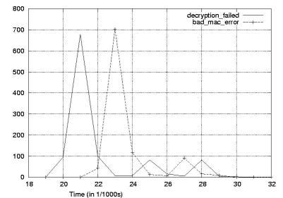
Preventing the attack
Discovered in 2002 (Vaudenay)
Correct TLS protocol to avoid such “padding oracle”
  Most TLS1.0 implementations: respond with same alert (bad mac) in both cases
  TLS1.1: standardized this
But canvel 2003: side channel “padding oracle”!
  Must correct also implementation!!
  TLS1.1: always perform MAC even if malformed msg
Source: canvel 2003

Slide 51
Lessons
Encrypt then MAC would NOT have permitted such attack
When dealing with crypto, we (networkers) need to be more careful in what we report…
  The least, the better
Crypto implementations are extremely critical
  Side channel attacks
  Don’t implement crypto yourself!

Slide 52
Is the attack practical?
Apparently no
  Bad_mac and decryption failed: fatal alerts
  TLS connection aborted
  Next connection will have different key!
But… actually performed on IMAP (Vuagnoux & Canvel, 2003)
  Email IMAP client periodically sends login/passwd every few minutes (1-5)
  Resulting TLS msg plaintext
    XXXX LOGIN "username" "password"<cr><nl><MAC><PAD><LEN>
  C→ S intercepted with MITM attack (DNS spoofing), and CCA attack performed
    Connection abort not an issue
    Attack (optimized with further dictionary attack strategies) successful in at most few hours

Slide 53
Fixes and follow-ups
TLS1.2:
  If padding fails, validate MAC in any case
Devil is in the details
  But which data is validated? If padding fails, no way to know message size versus padding size
  TLS1.2 solution: use the whole data for validation
    But this is more data than a correct message!!
    May require one extra compression function in the HMAC → extra time
2013, Lucky thirteen, kenny paterson
  Attack using this very subtle timing channel!!!

Slide 54
CRIME attack: compression leaks
(USABLE) information!

Slide 55
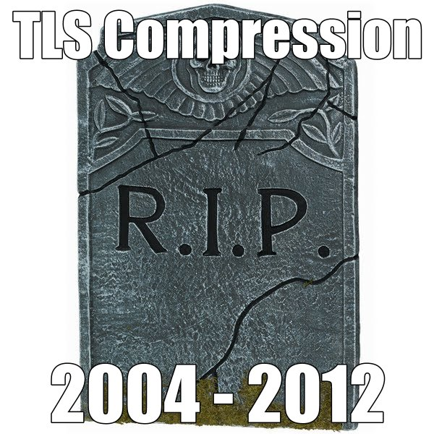
TLS Compression is harmful
Compression disabled in Chrome after september 2012 CRIME attack
Actually, more general than TSL: similar attack in other settings
  TIME – Timing Info-leaks Made Easy
  BREACH - Browser Reconnaissance and Exﬁltration via Adaptive Compression of Hypertextì
    Extends attack to HTTP compression
Not a problem of TLS, but a more general problem!
  Actually, potential vulnerability known since 2002, but disregared for 10 years
    Kelsey, Compression and Information Leakage of Plaintext
Source: T. Duong, J. Rizzo

Slide 56
Compression leaks size information
AAAABC
compress
4ABC
encrypt
X&%$
Size = 4 bytes
ABCDEF
compress
ABCDEF
encrypt
&$£A£$
Size = 6 bytes

Slide 57
Combining compression with Plain text injection – concept idea
Your data, unknown to attacker
SHARON
But attacker can see size of
Compressed+encrypted data
xxxxxx
SHARON
Attacker can repeatedly inject chosen plaintext prior to your data, and SEE size of
encrypted + compressed result
Compress+encrypt
xxxxxxxx
AAA[unknown]
BBB[unknown]
SSS[unknown]
3ASHARON
3BSHARON
xxxxxxxx
xxxxxxx
4SHARON
What’s the first letter of your data? Pretty easy, isn’t it? ☺

Slide 58
Attack made practical
CRIME = Compression Ratio Info-leak Made Easy
  Duong and Rizzo, again, september 2012
  Works IRRESPECTIVE of cipher!!
Practical enablers
  Injection of chosen text prior to user data
    Reusing BEAST software tools
  Suitably chosen injected text
    Relates to compression method details
      Practically done for DEFLATE, in principle can be extended to other compression methods
  Some extra tech details (skipped)

Slide 59
Attack details (simplified)
Attack relies on DEFLATE details
DEFLATE (jointly) uses two sub-algorithms
  Huffman coding
    we don’t discuss it, to keep simple
  LZ77: replaces repeated 3+ char strings with
  (offset,size) pointers
GIUSEPPE BIANCHI AND MARCO BIANCHINI 36B
GIUSEPPE BIANCHI AND MARCO (-18,7)NI 31B

Slide 60
Attacker injects chosen text
Legitimate user text:
  known header + unknown secret
  e.g. authentication token: passwd=alice%01
Message crafted by attacket
  Att_input + [header + secret]
  Repeater many times
Attacker sees
  Len(encrypt(compress(att_input+header+secret)))

Slide 61
How to chose input
GET /comment:twid=a HTTP/1.1 Cookie: twid=flavia\r\n
GET /comment:twid=a HTTP/1.1 Cookie: (-24,5)flavia\r\n
Repeat guesses… until
GET /comment:twid=f HTTP/1.1 Cookie: twid=flavia\r\n
GET /comment:twid=f HTTP/1.1 Cookie: (-24,6)lavia\r\n
1 byte shorter!!
And now start guessing second character as well!!
GET /comment:twid=fa HTTP/1.1 Cookie: twid=flavia\r\n
GET /comment:twid=fa HTTP/1.1 Cookie: (-24,6)lavia\r\n
GET /comment:twid=fl HTTP/1.1 Cookie: twid=flavia\r\n
GET /comment:twid=fl HTTP/1.1 Cookie: (-24,7)avia\r\n
And so on, linearly with secret size (again!)

Slide 62
A bit more complex than this, but… enough to sketch the idea
Compression works in bits, not bytes
  With huffman coding as well
  Must be careful to get at least a byte difference
Done on two protocols
  TLS
  SDPY (http2.0 candidate)
Some technical differences
  TLS: includes a further chosen boundary attack
    Very different boundary: TLS fragment (versus AES block in crime)
  SPDY: must handle compression state over multiple requests
    Uses compression dictionary window
Several optimizations to make the attack faster
  Less guesses
  compression size separately computed by attacker
More details @ http://www.ekoparty.org//archive/2012/CRIME_ekoparty2012.pdf

